Slide 1
-90 Ohm Termination is best now ( due to 100Ohm characteristic of ArtyS7's ja, jb port)
-'Arbitrary' 800MHz data input seems to be impossible-> only pulse can be input for ArtyS7
->require buffer circuit connecting artyS7 and fast output circuit
fast circuit
(800MHz output)
artyS7
buffer
100Ohm
100Ohm
50Ohm

Slide 2
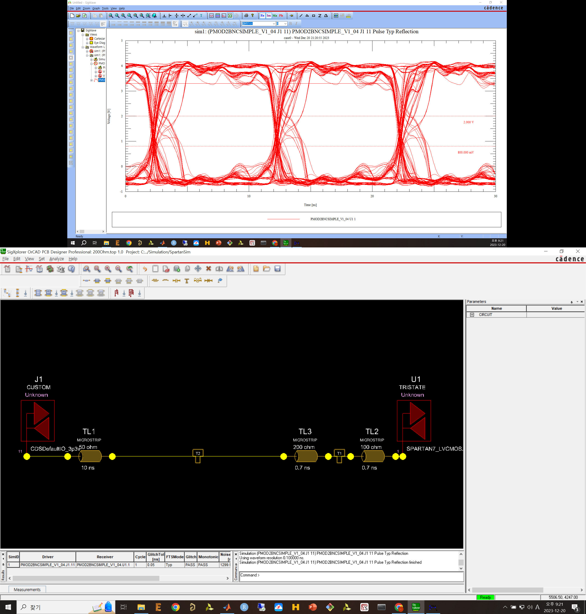
100MHz Jumper-ArtyS7 w/o resistor

Slide 3
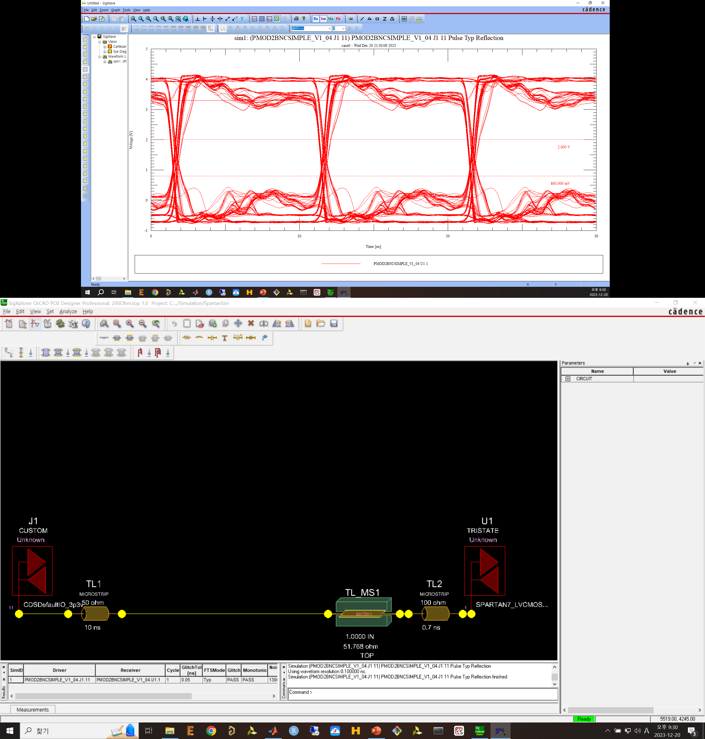
100MHz Board-ArtyS7 w/o resistor

Slide 4
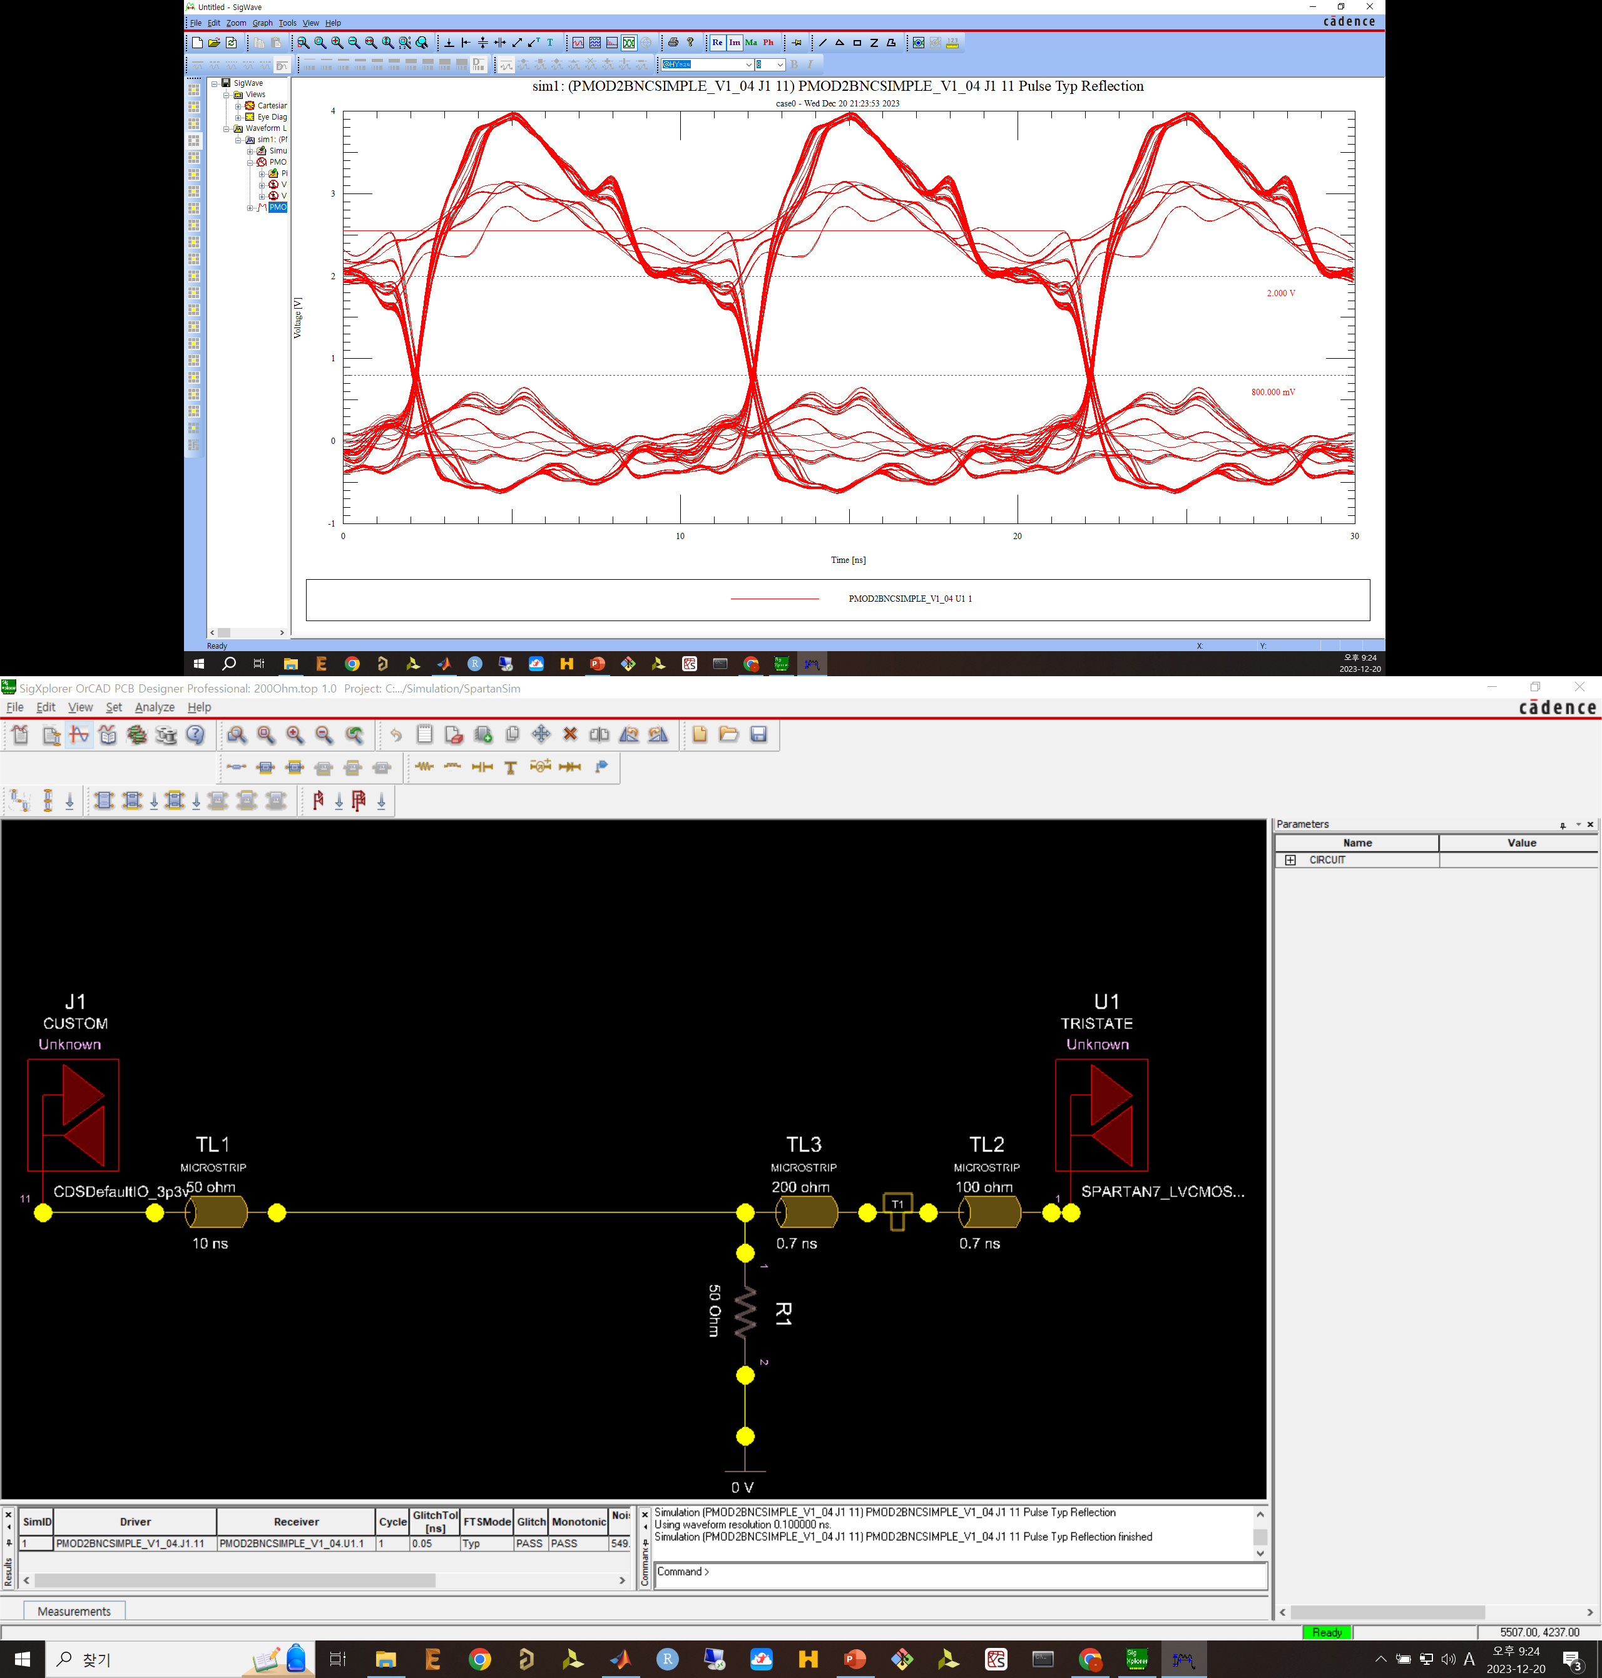
100MHz Jumper-ArtyS7 with resistor

Slide 5
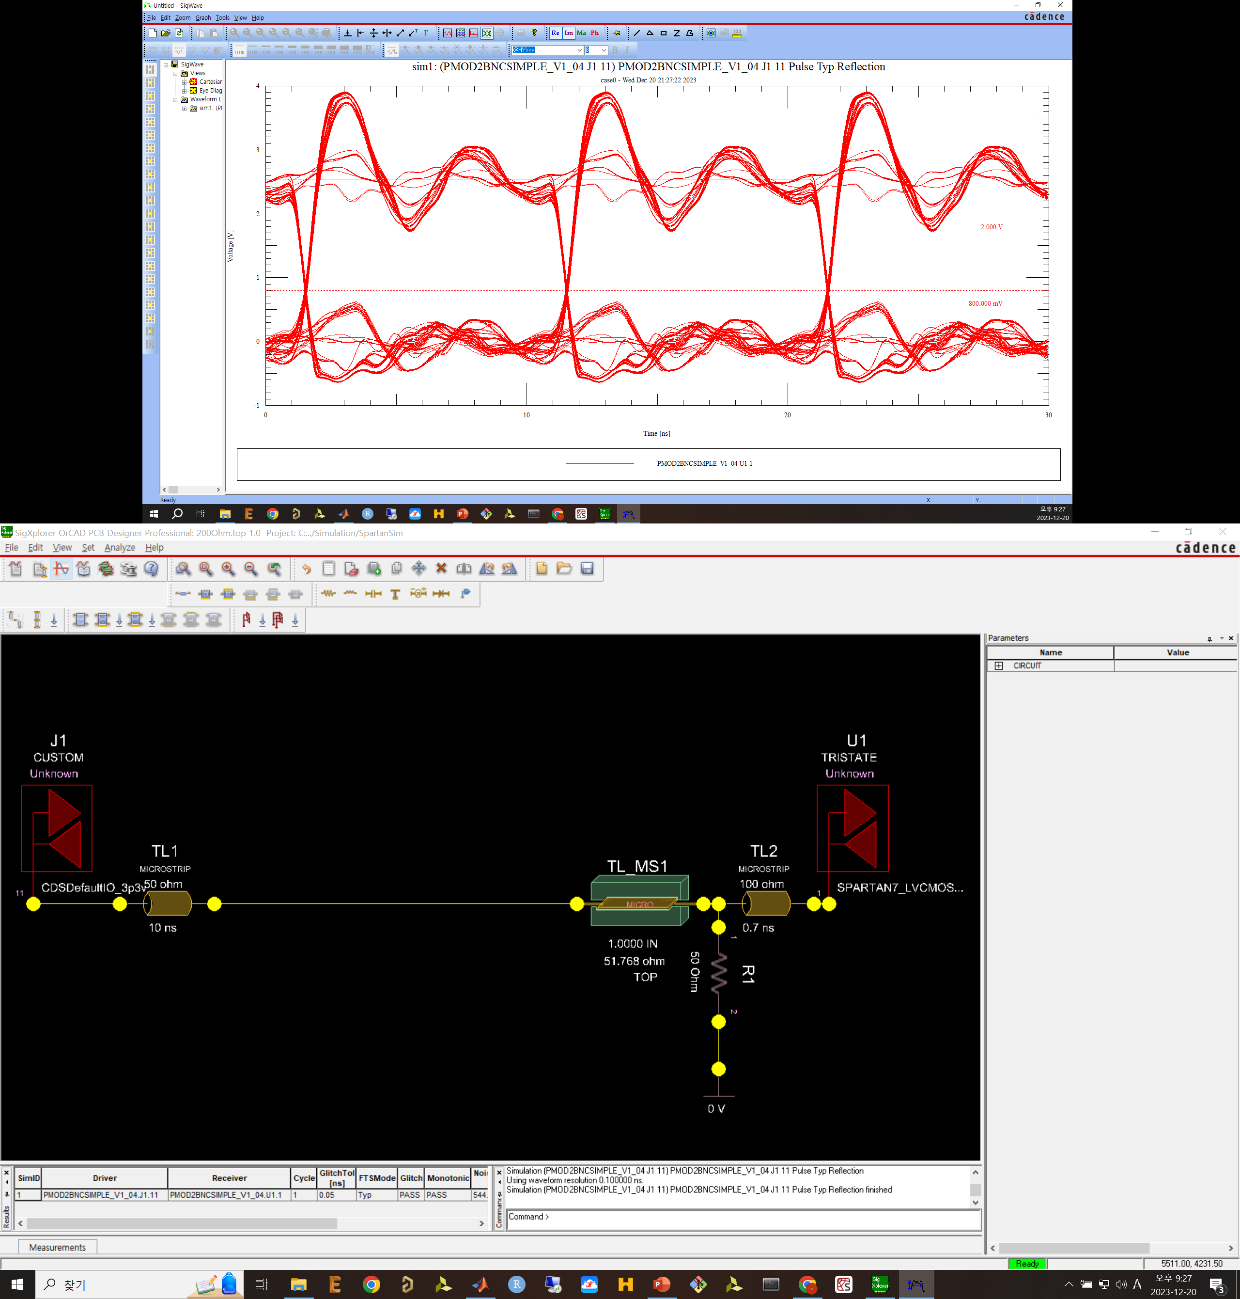
100MHz Board-ArtyS7 with resistor

Slide 6
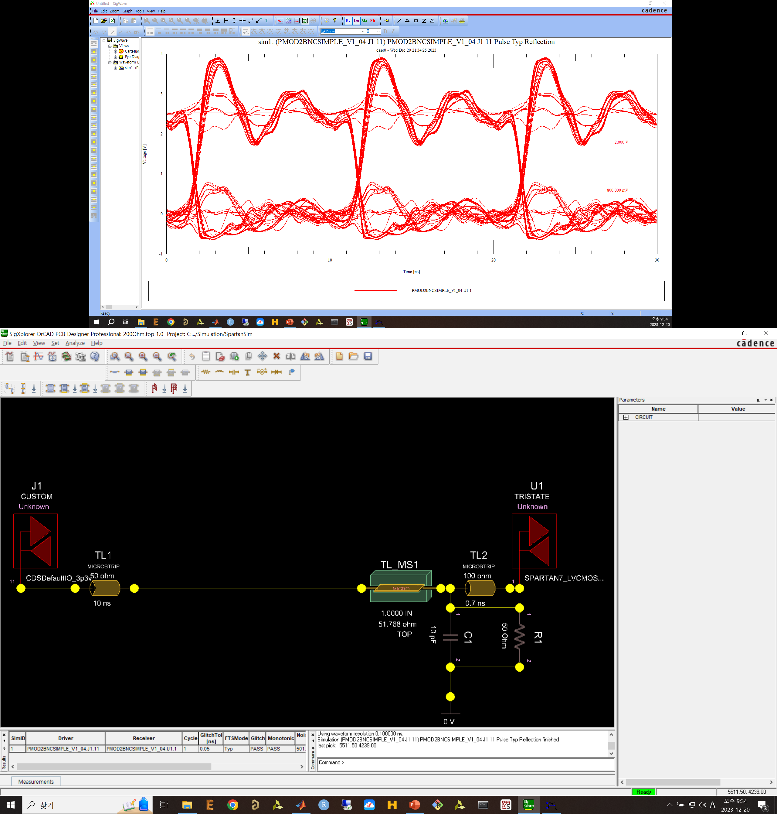
100MHz Board-ArtyS7 with RC

Slide 7

100MHz Board-ArtyS7 with 40 Ohm

Slide 8
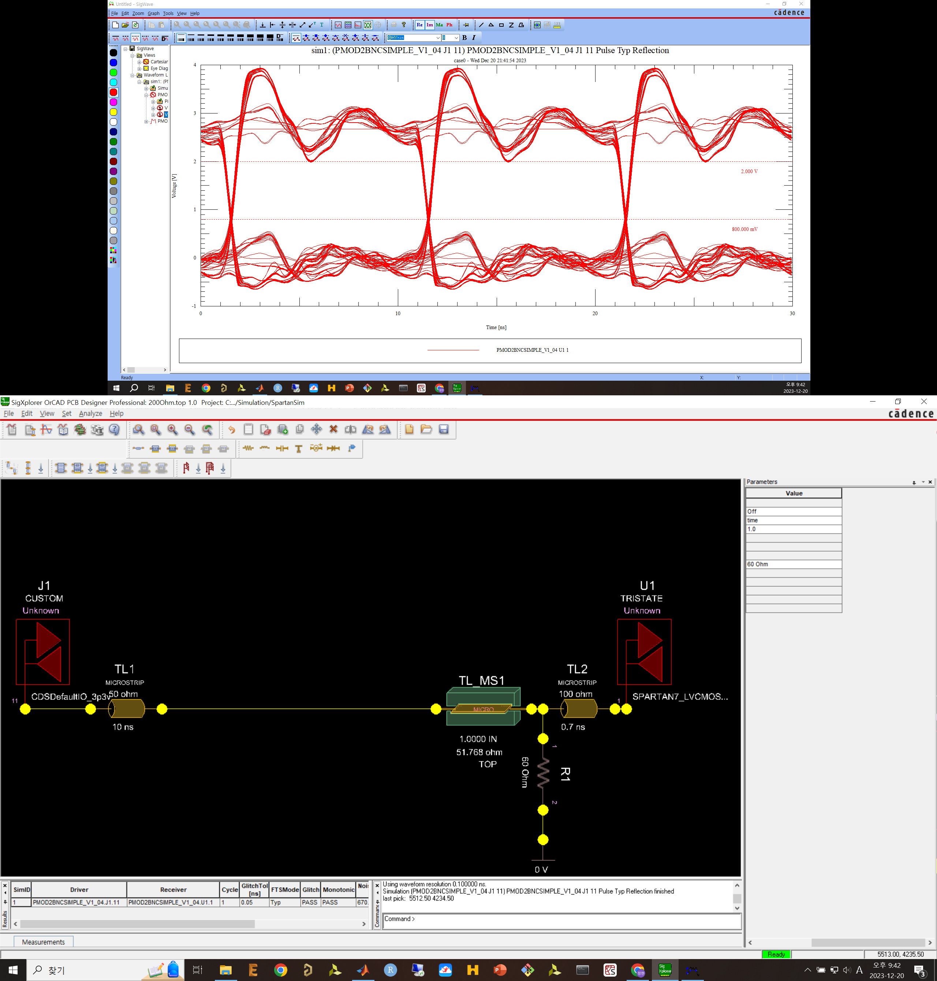
100MHz Board-ArtyS7 with 60 Ohm

Slide 9
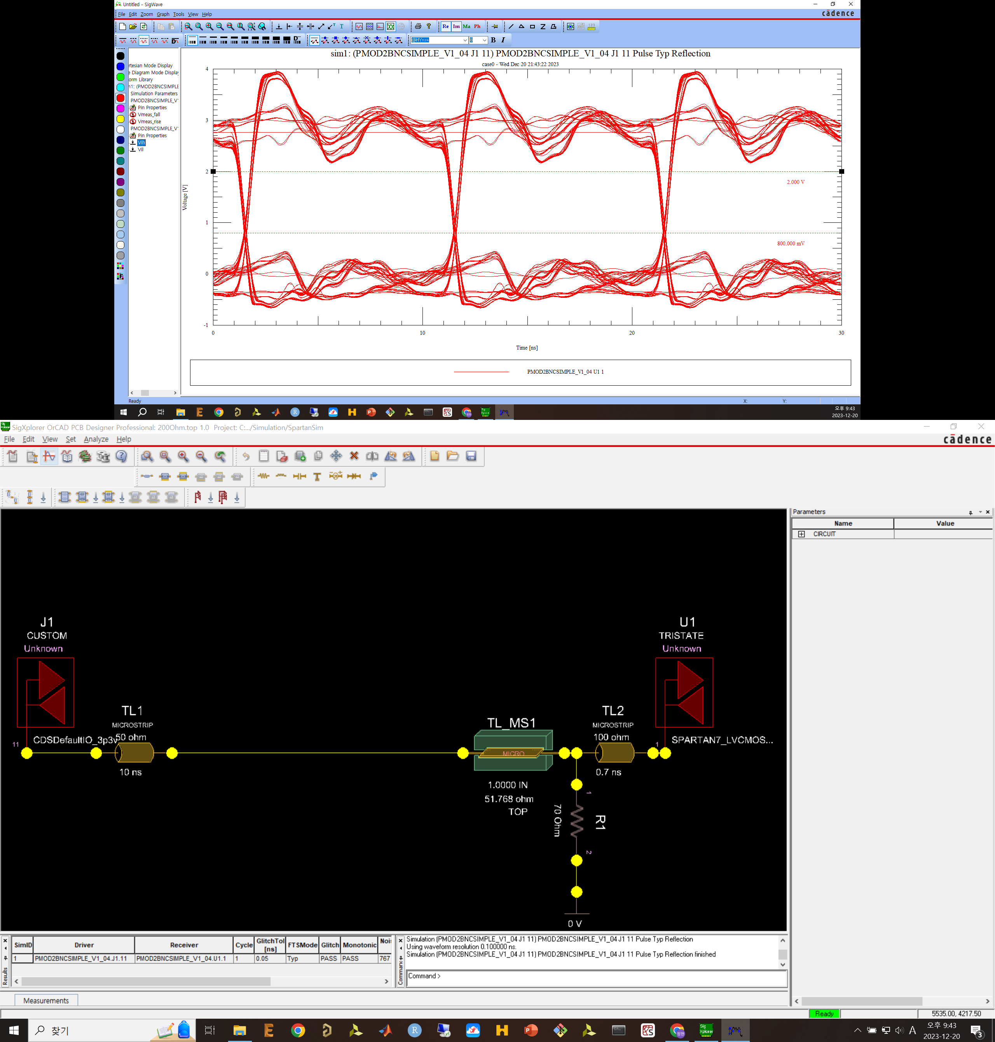
100MHz Board-ArtyS7 with 70 Ohm

Slide 10
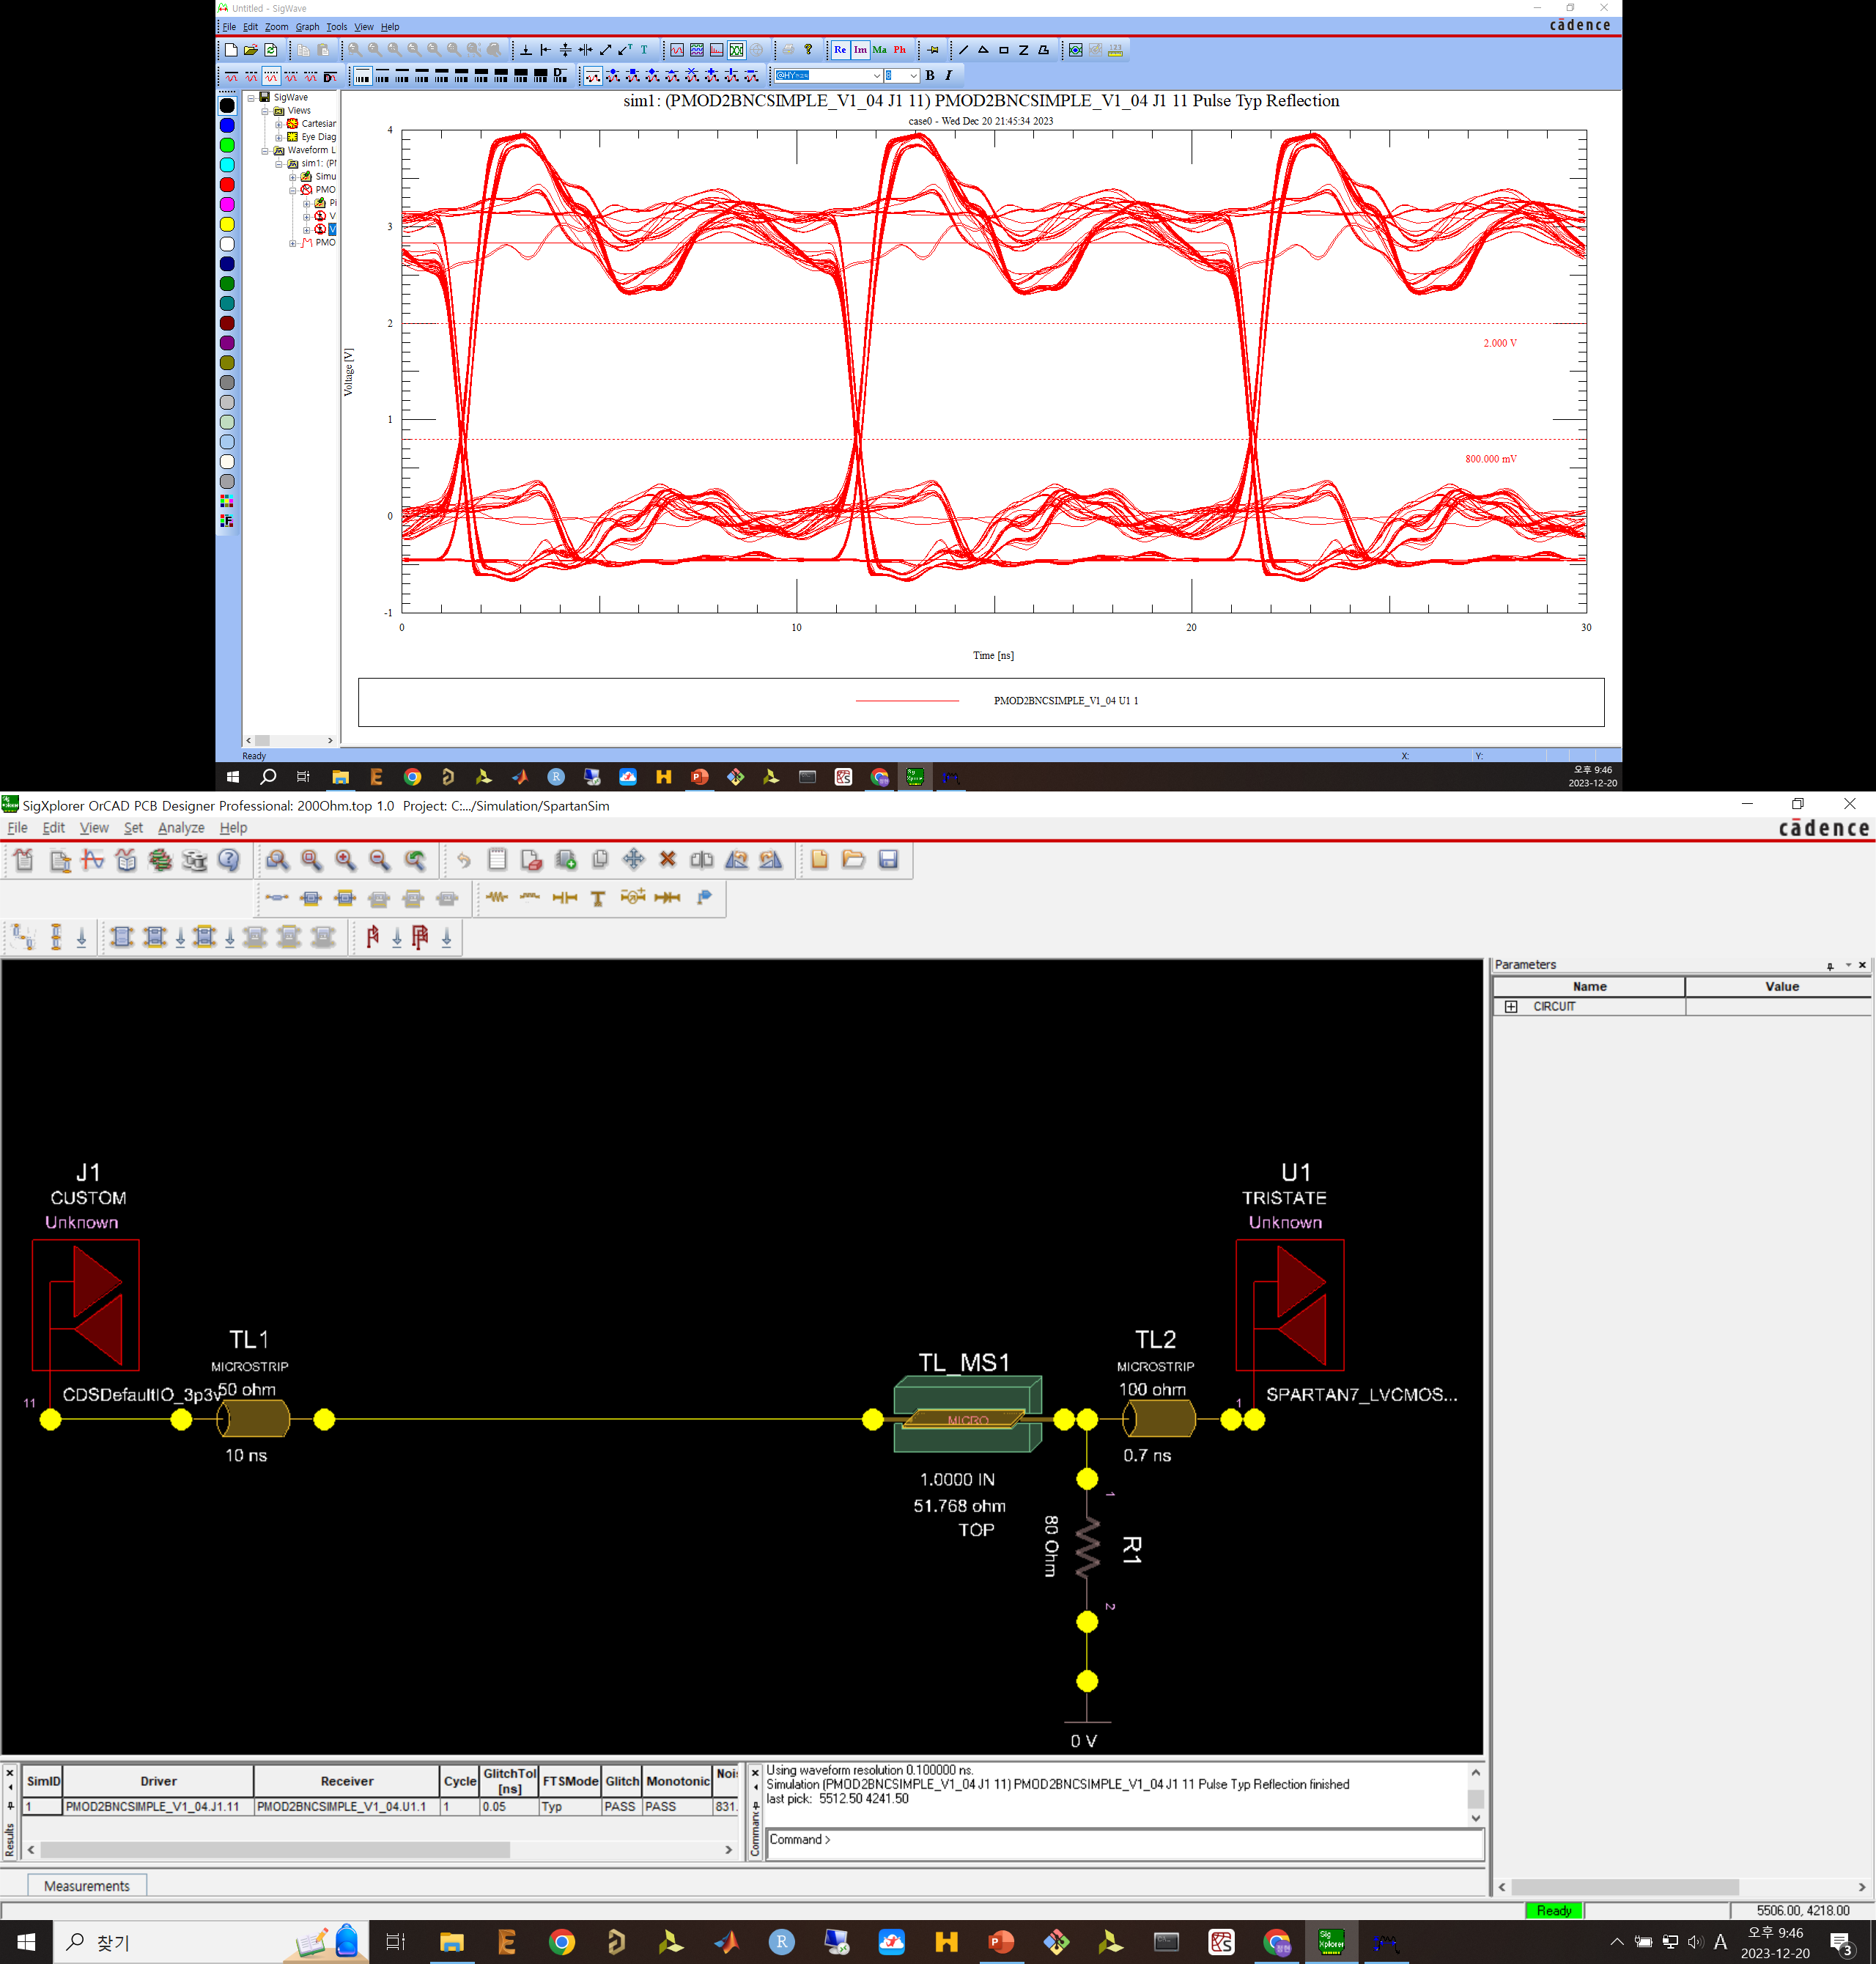
100MHz Board-ArtyS7 with 80 Ohm

Slide 11

100MHz Board-ArtyS7 with 90 Ohm

Slide 12
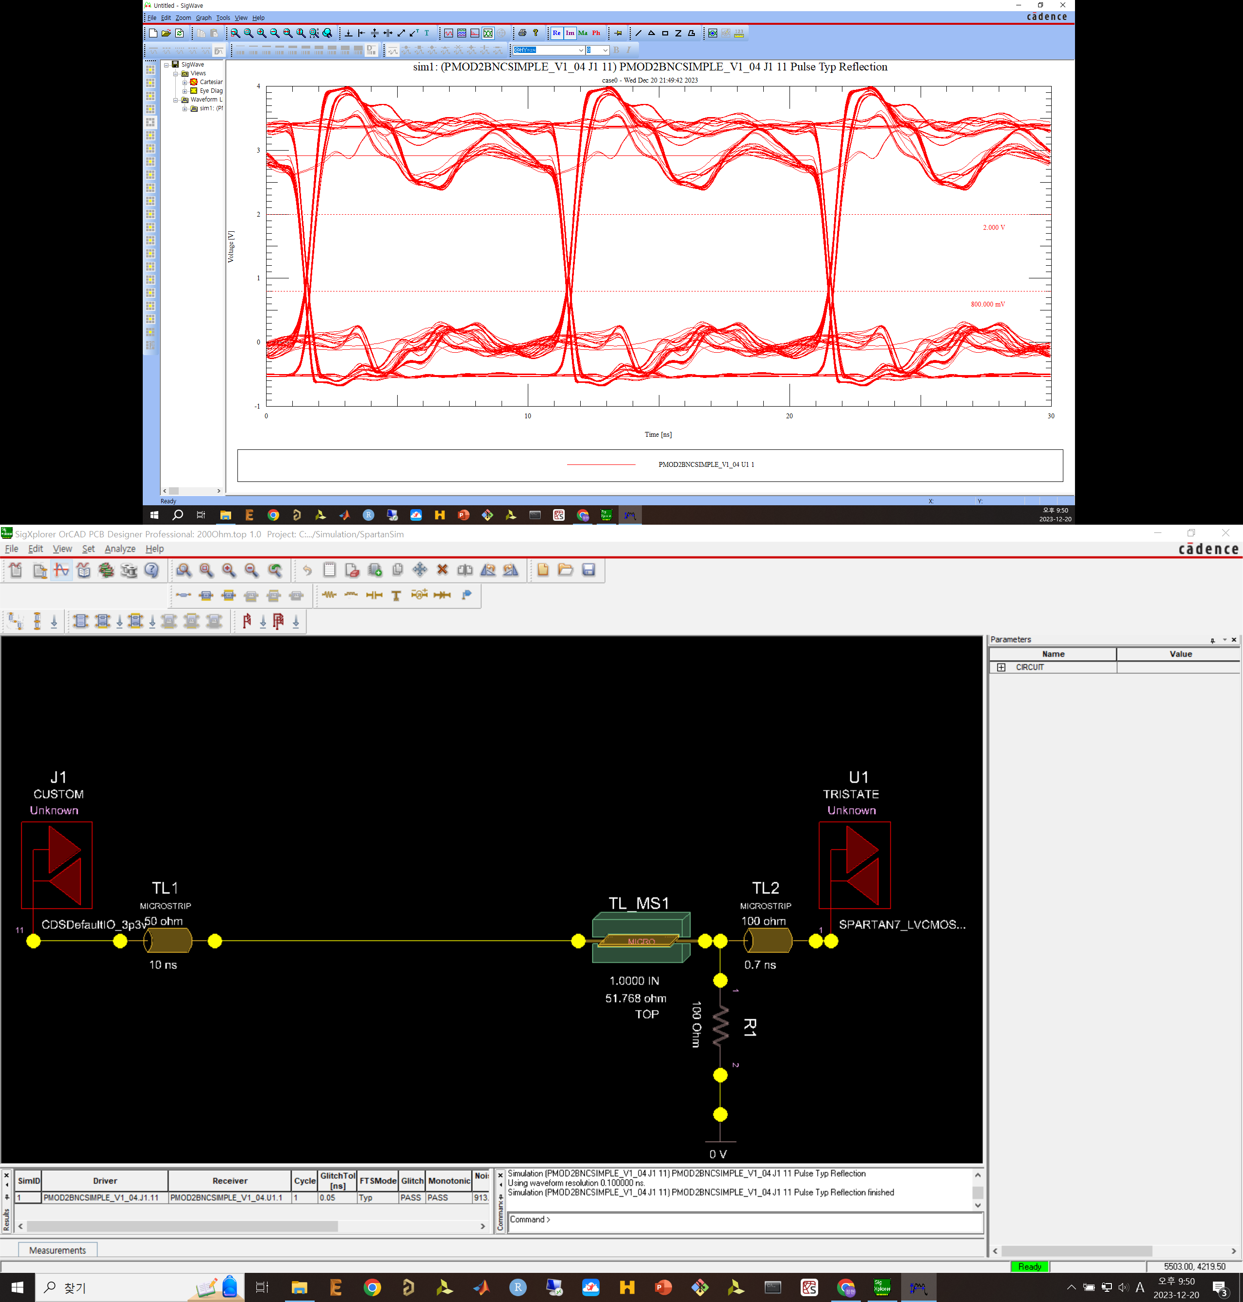
100MHz Board-ArtyS7 with 100 Ohm

Slide 13
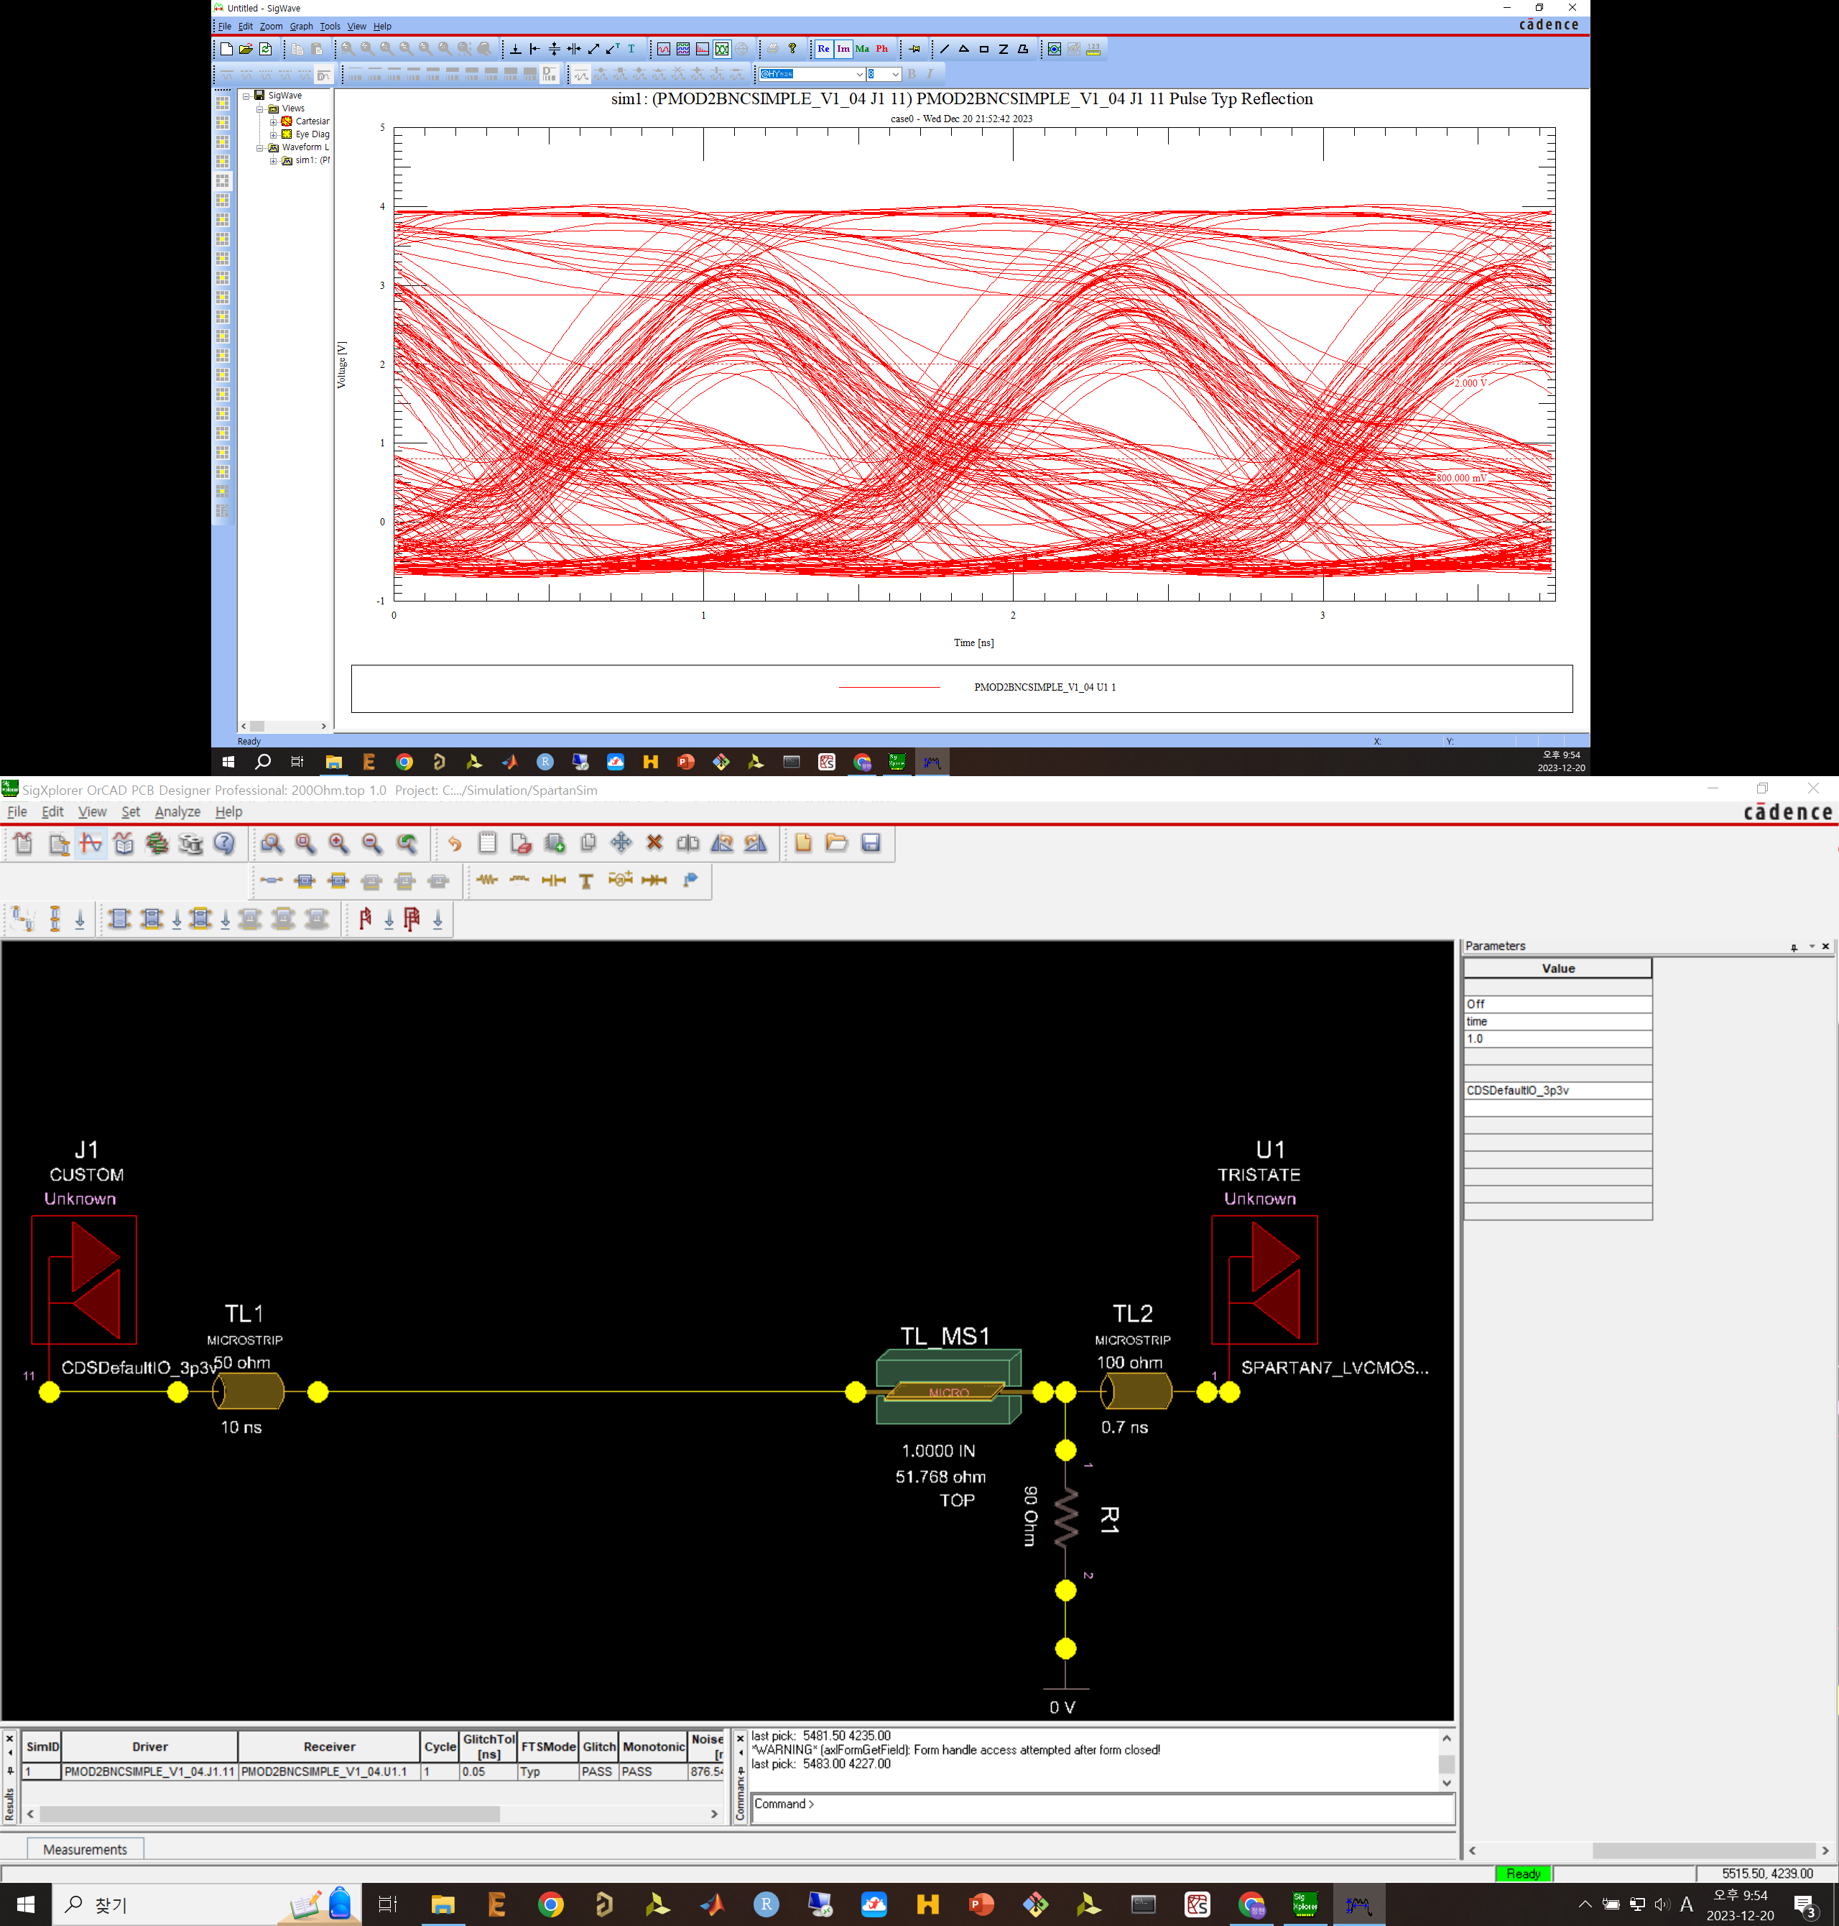
800MHz with 90Ohm

Slide 14
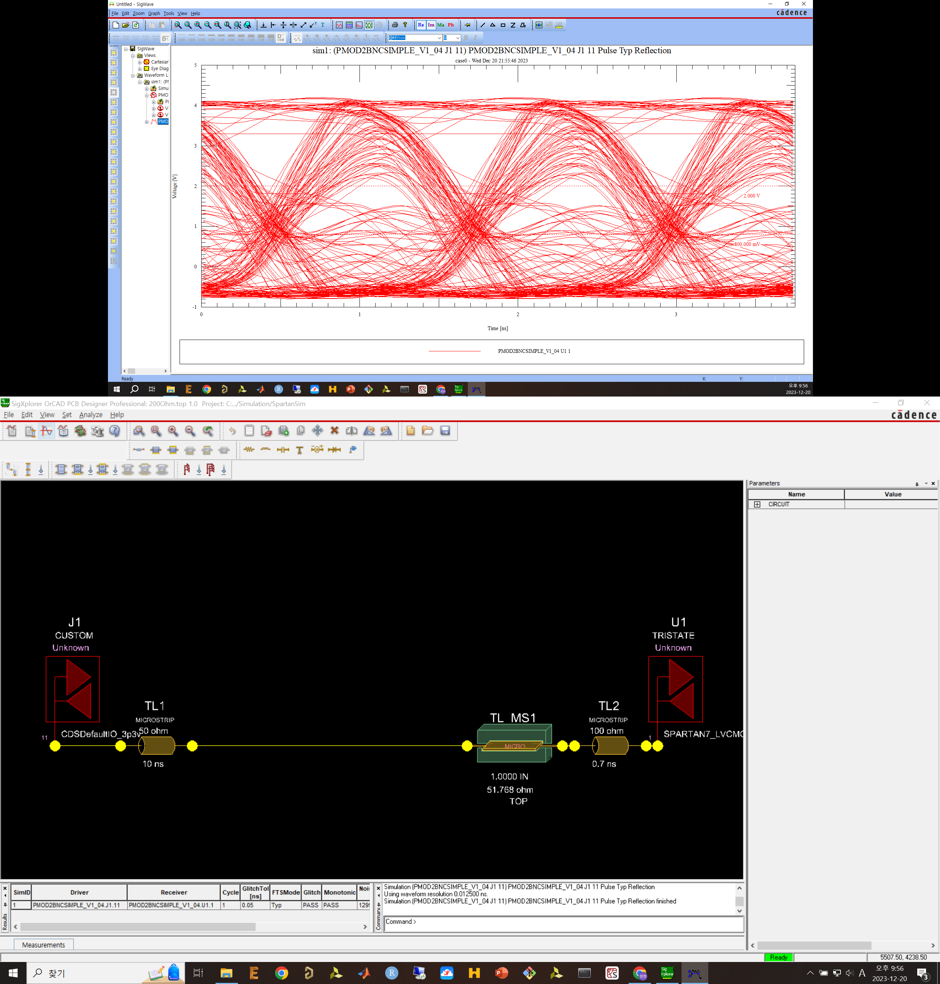
800MHz w/o resistor

Slide 15
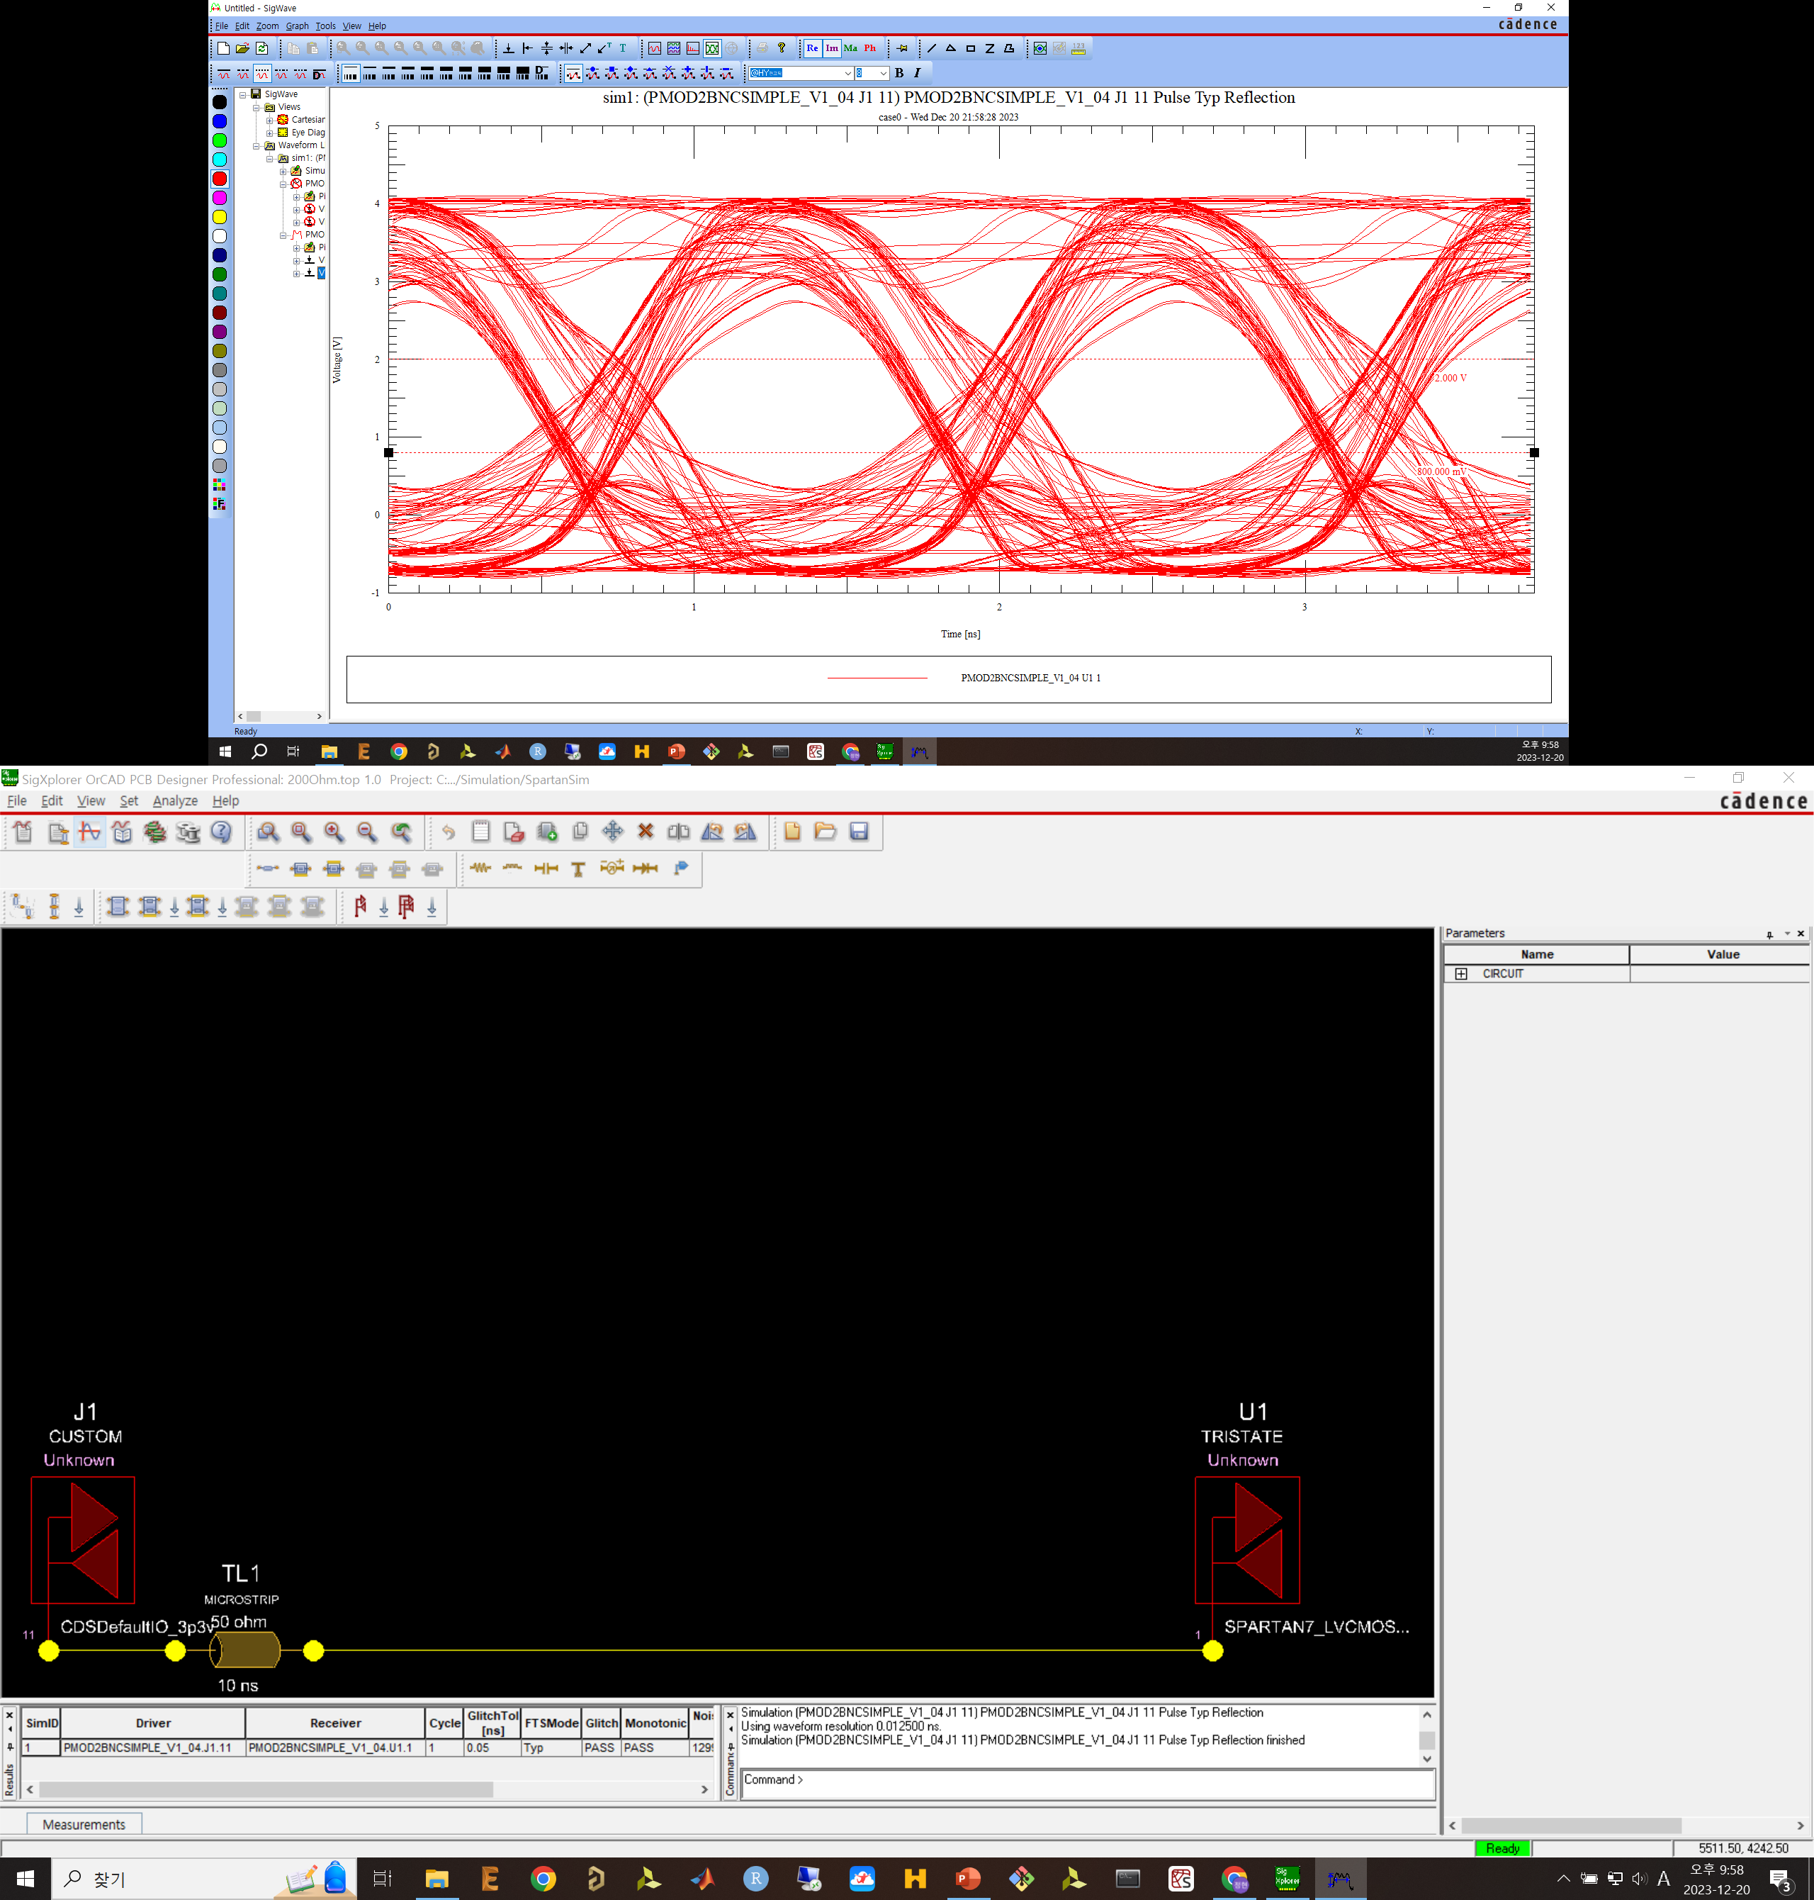
800MHz with matched trace, wihout resistor (no artys7)

Slide 16
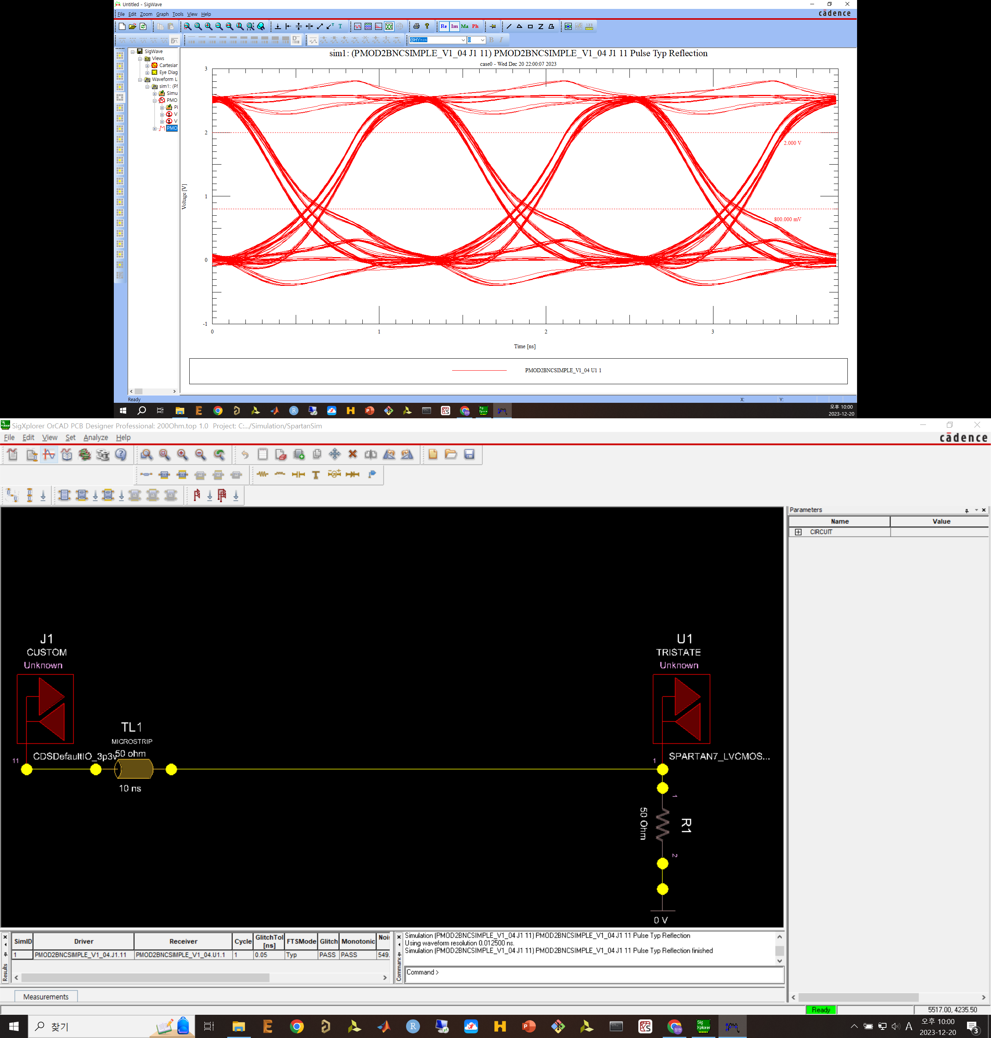
800MHz with matched trace, with 50Ohm (no artys7)

Slide 17
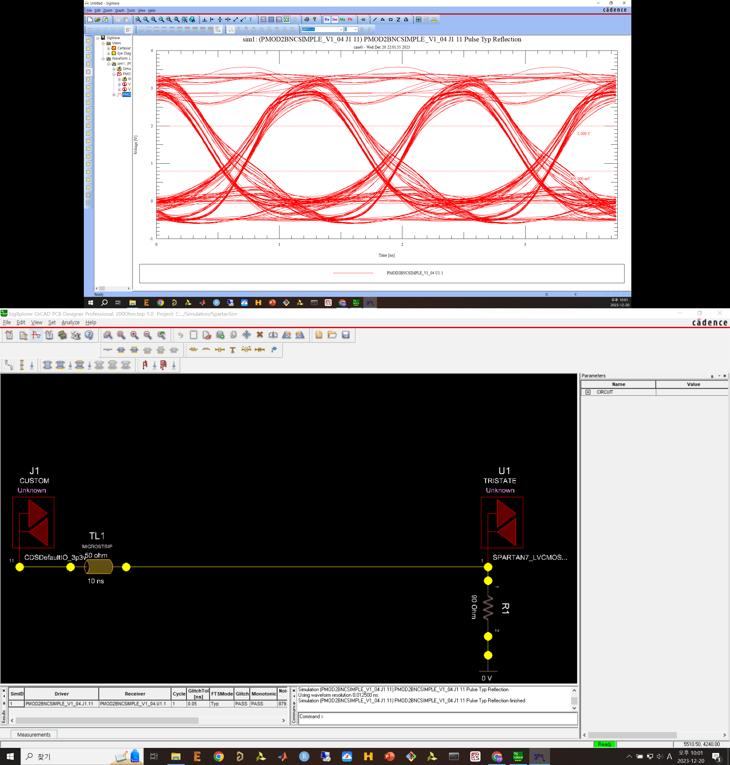
800MHz with matched trace, with 90Ohm (no artys7)

Slide 18
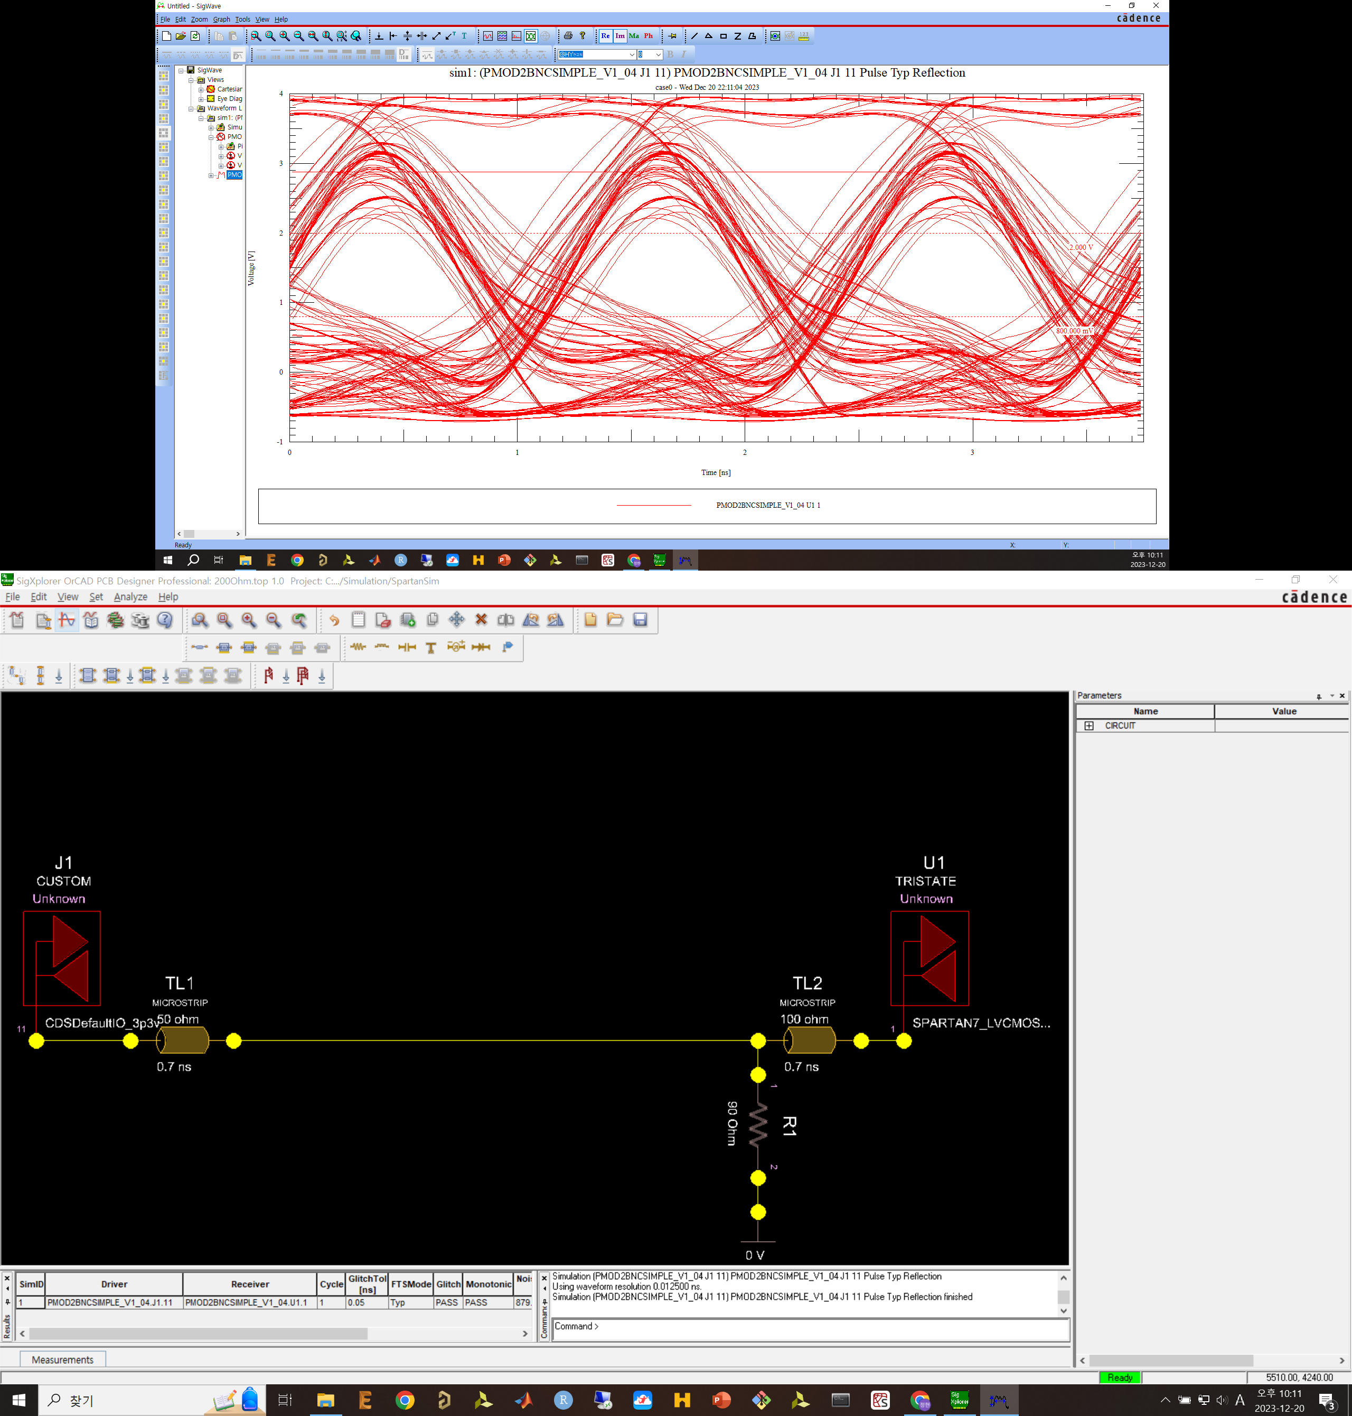
800MHz with matched trace, with 90Ohm and very short transmission line

Slide 19
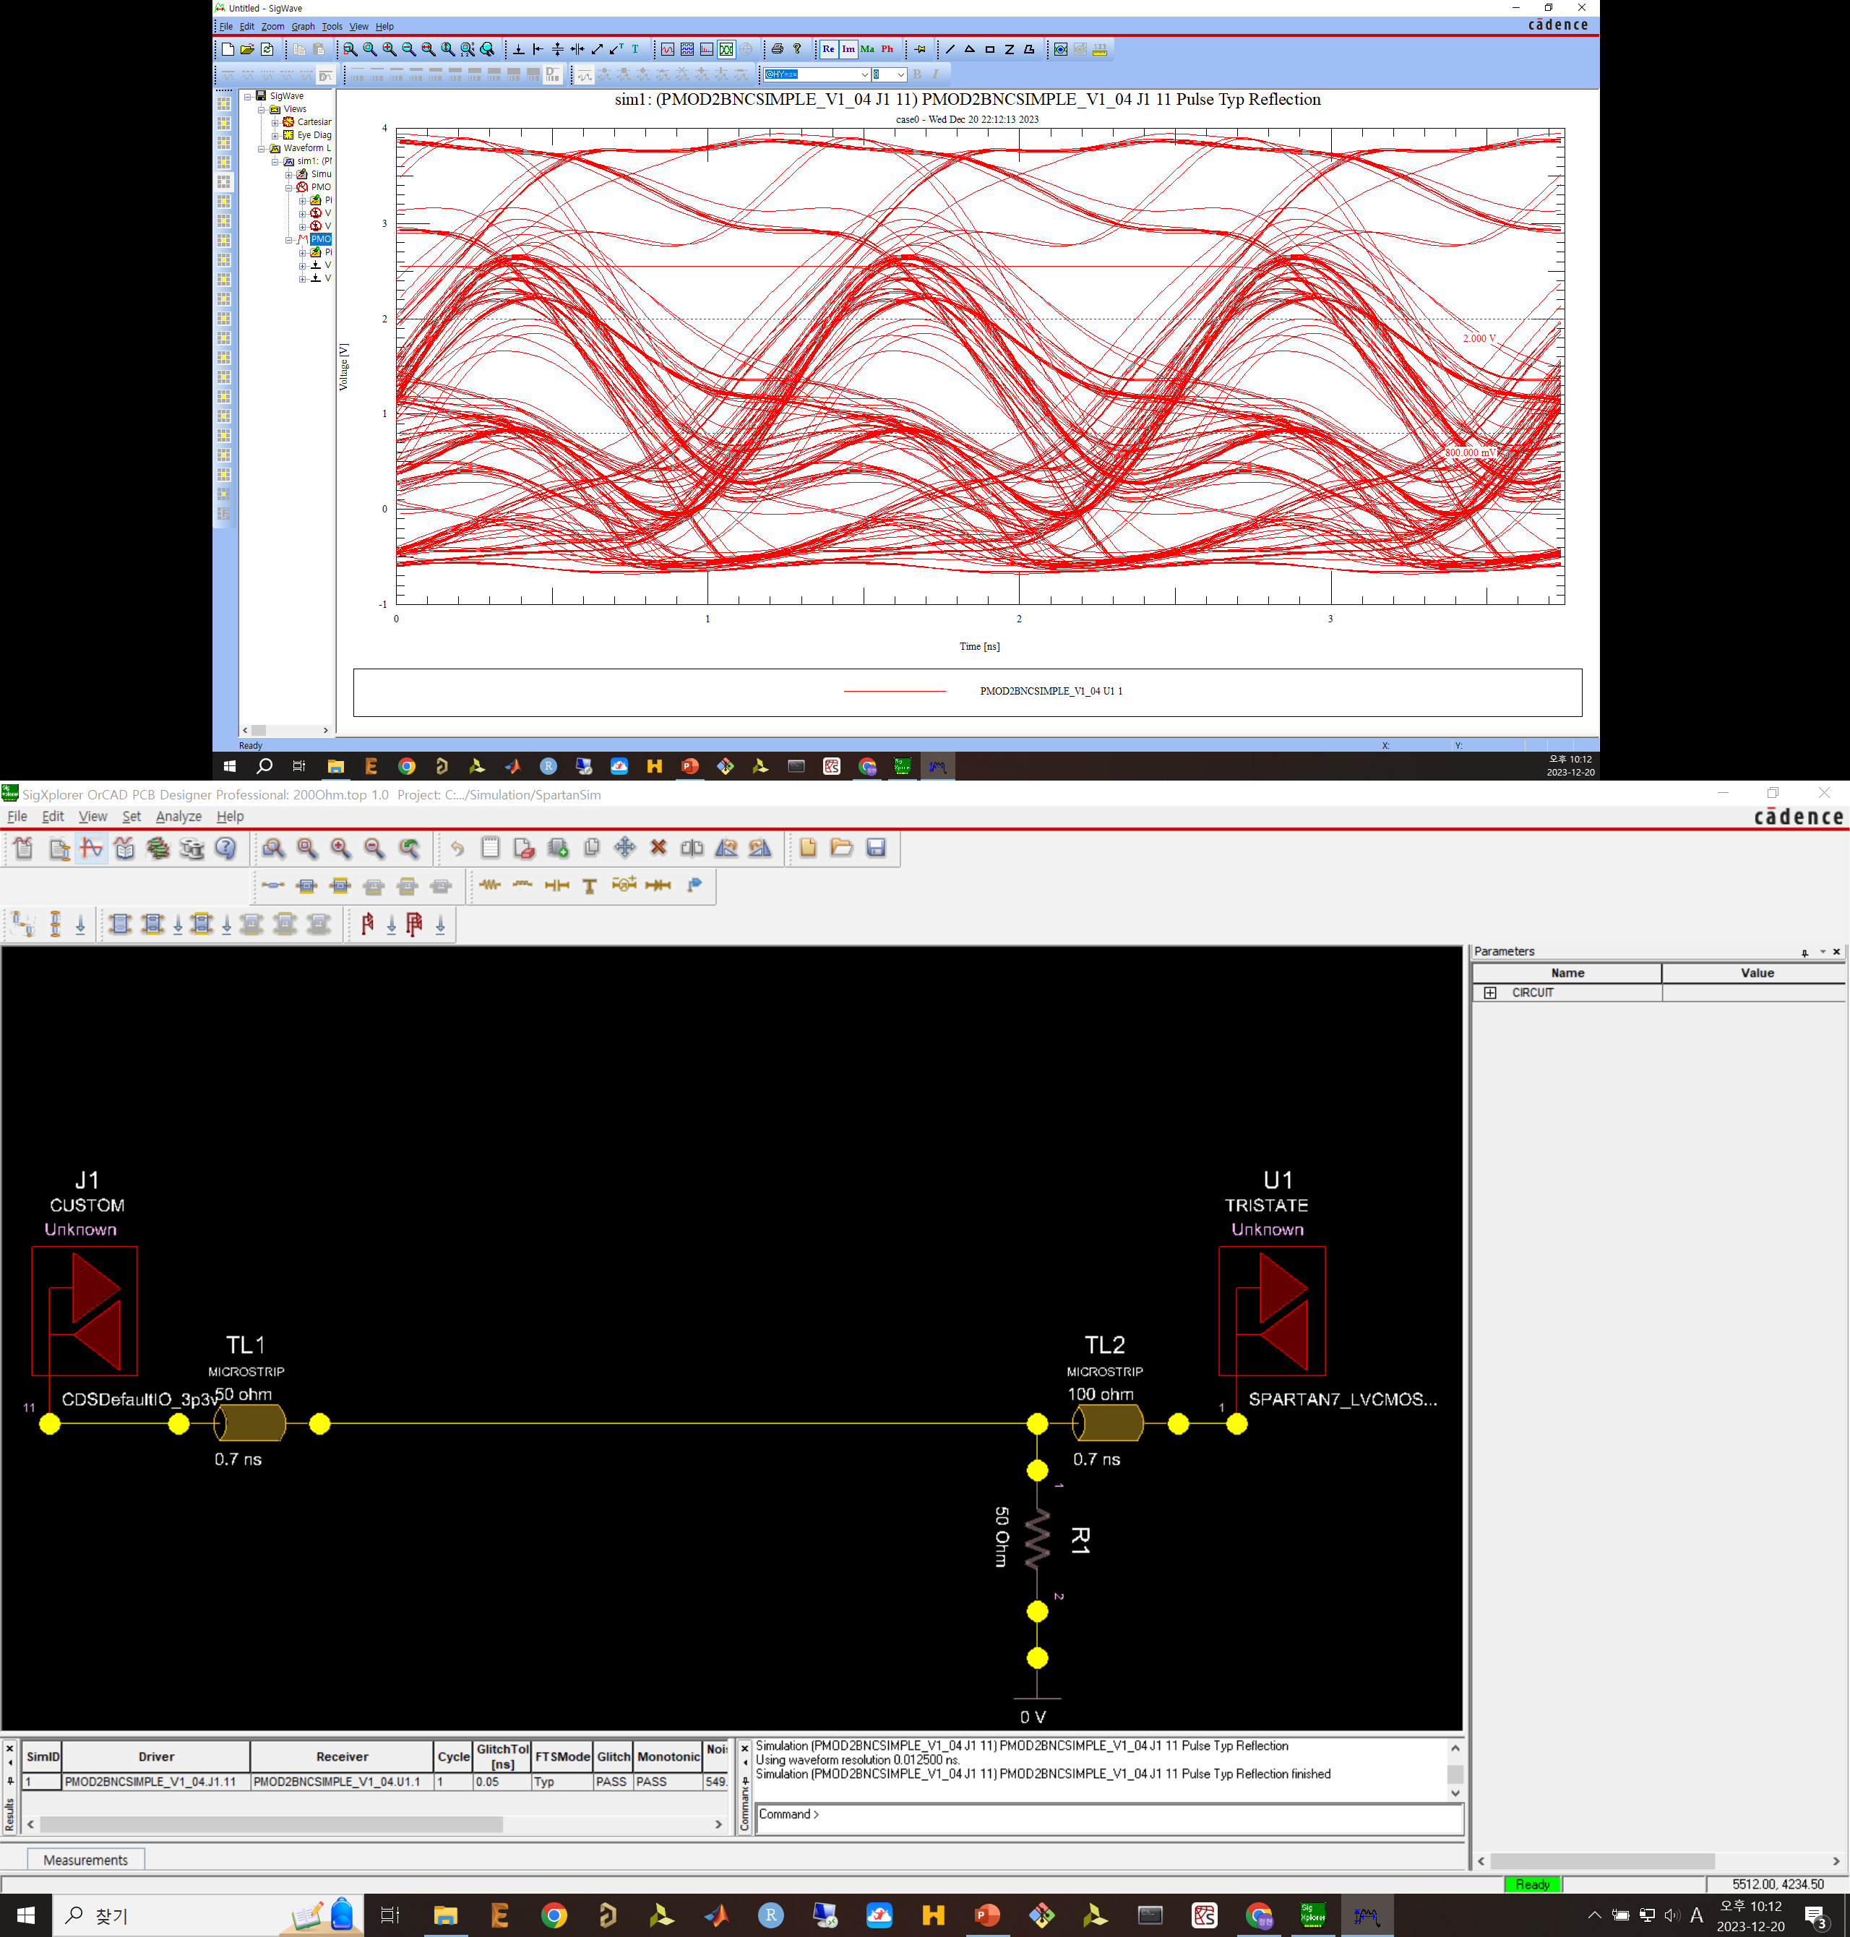
800MHz with matched trace, with 50Ohm and very short transmission line

Slide 20
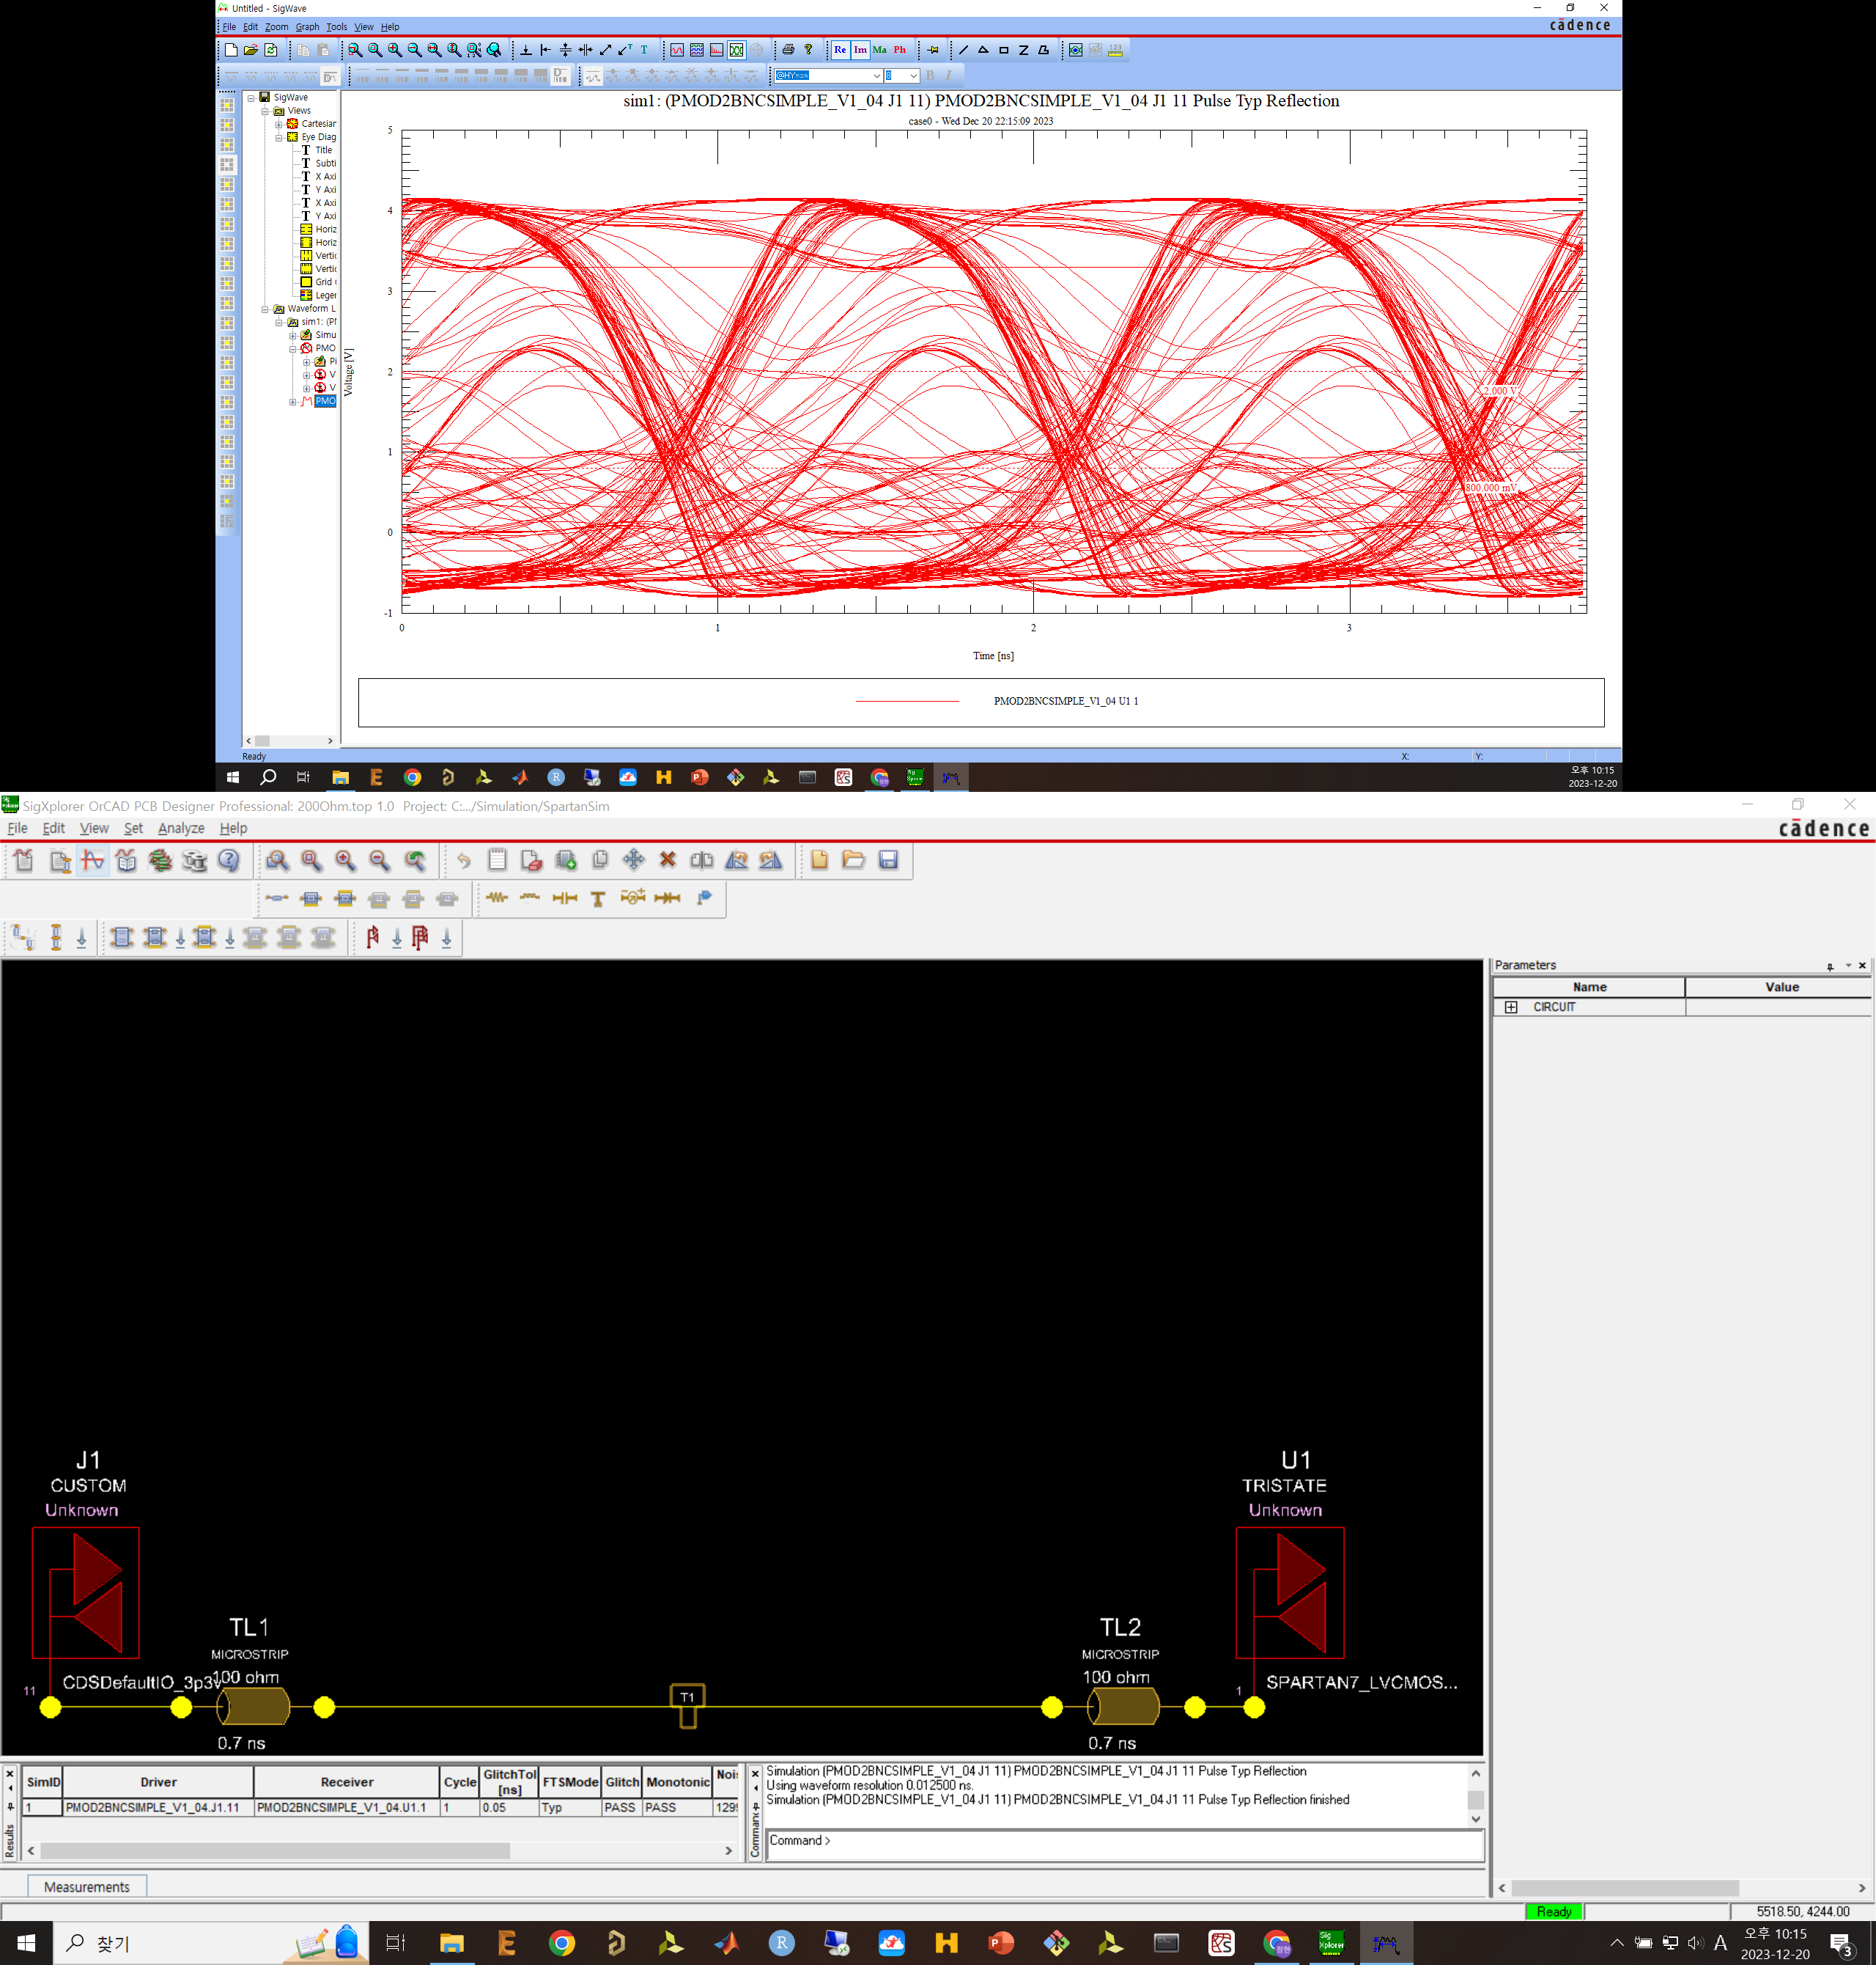
800MHz with matched trace, without resistor, and with 100Ohm transmission line

Slide 21
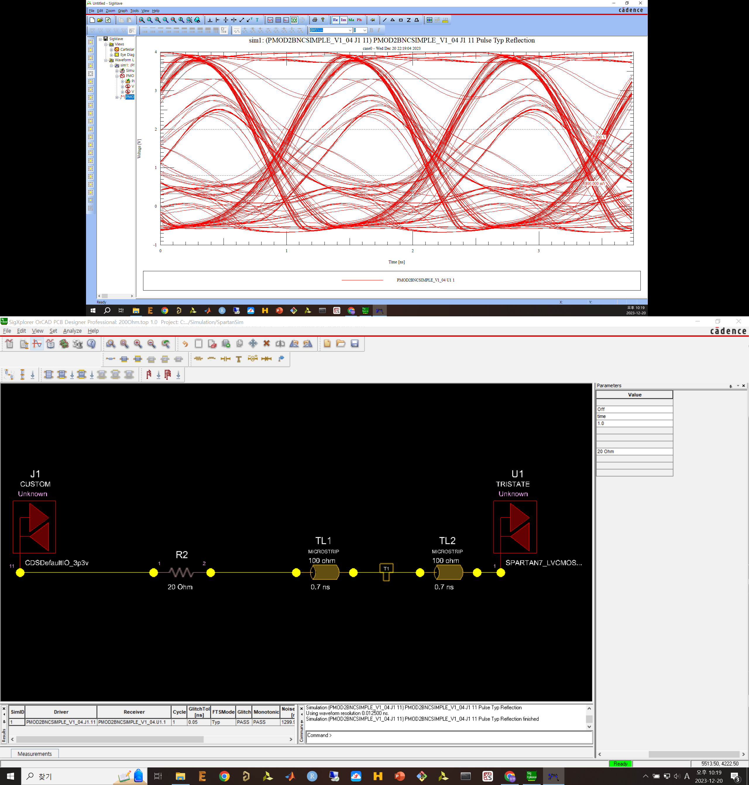
800MHz with matched trace, with 20Ohm series reistor

Slide 22
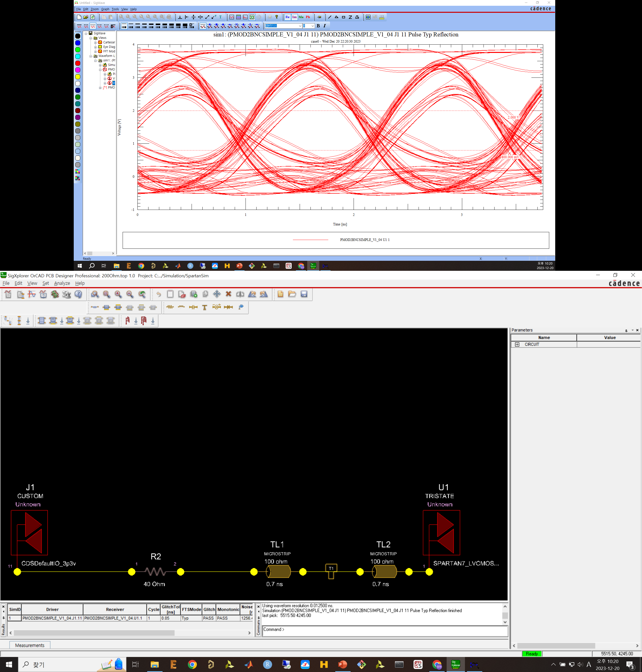
800MHz with matched trace, with 40Ohm series reistor

Slide 23
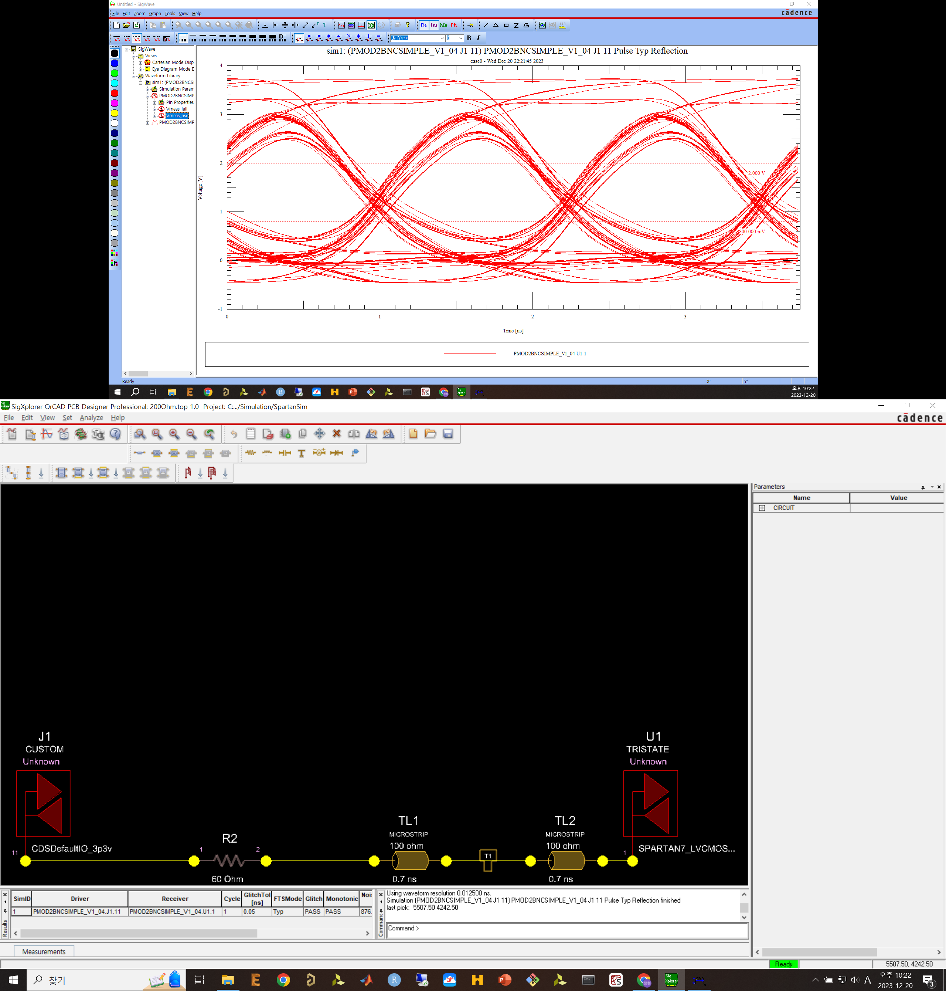
800MHz with matched trace, with 60Ohm series reistor

Slide 24
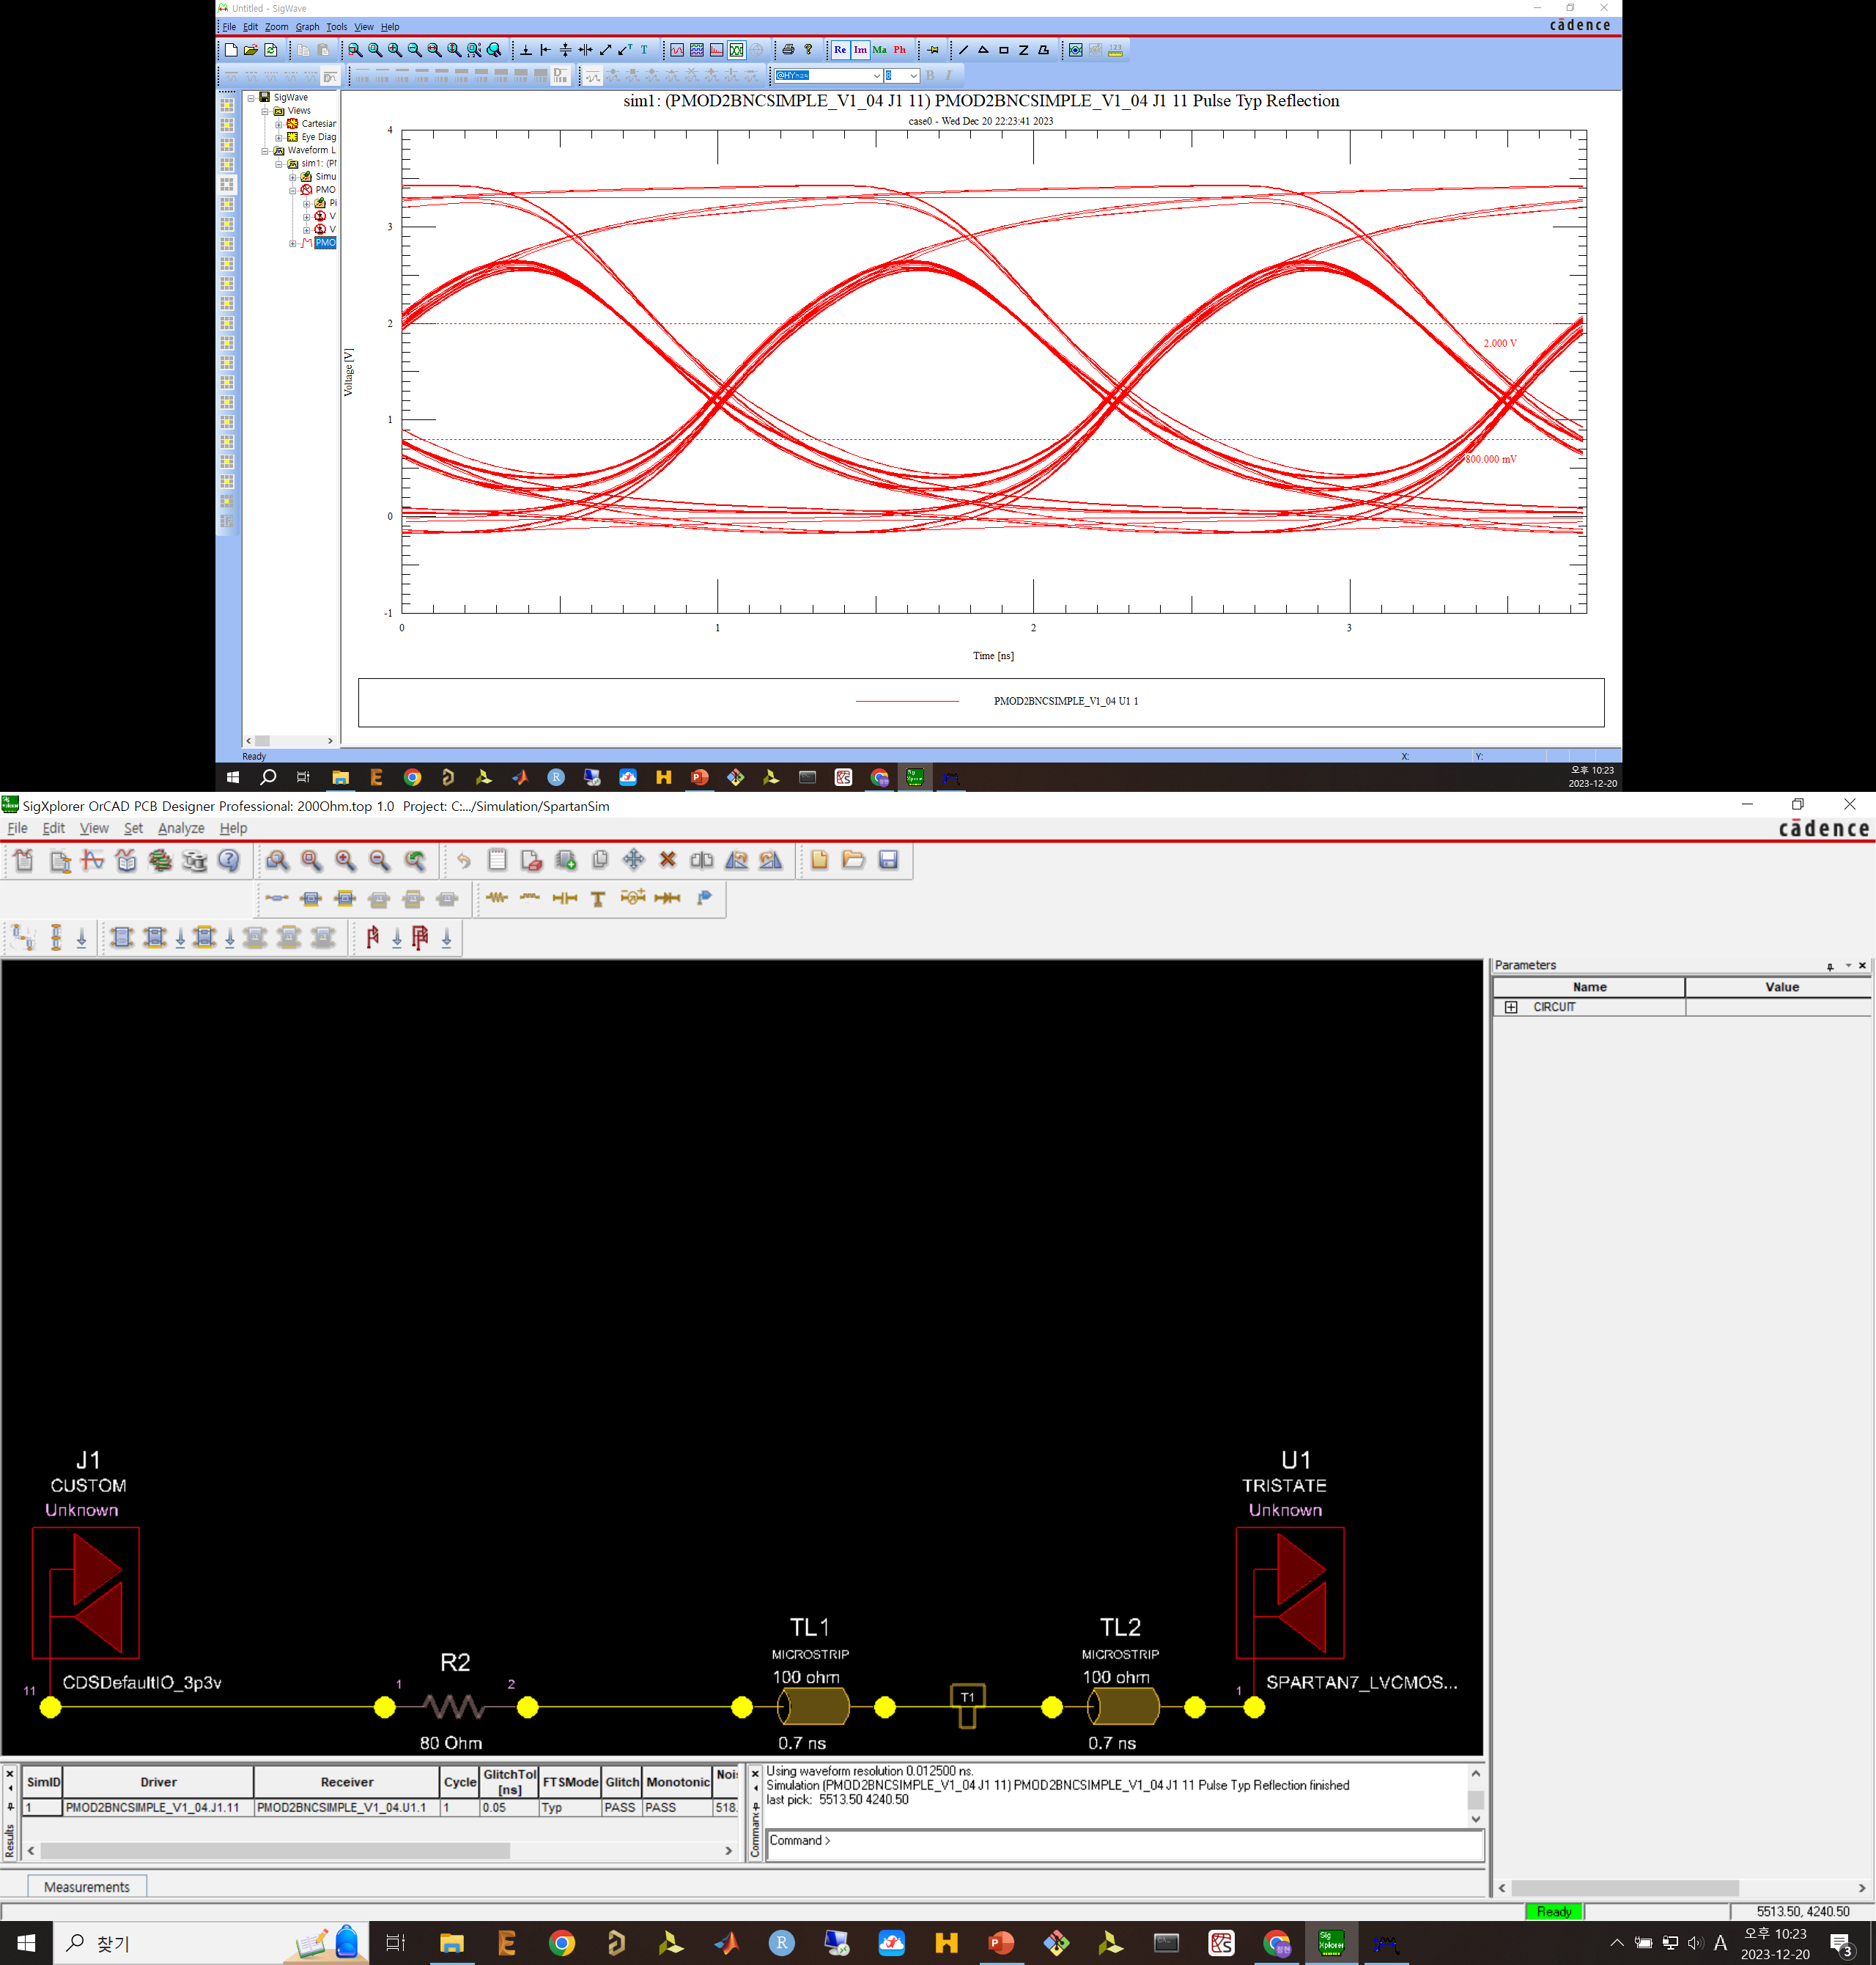
800MHz with matched trace, with 80Ohm series reistor

Slide 25
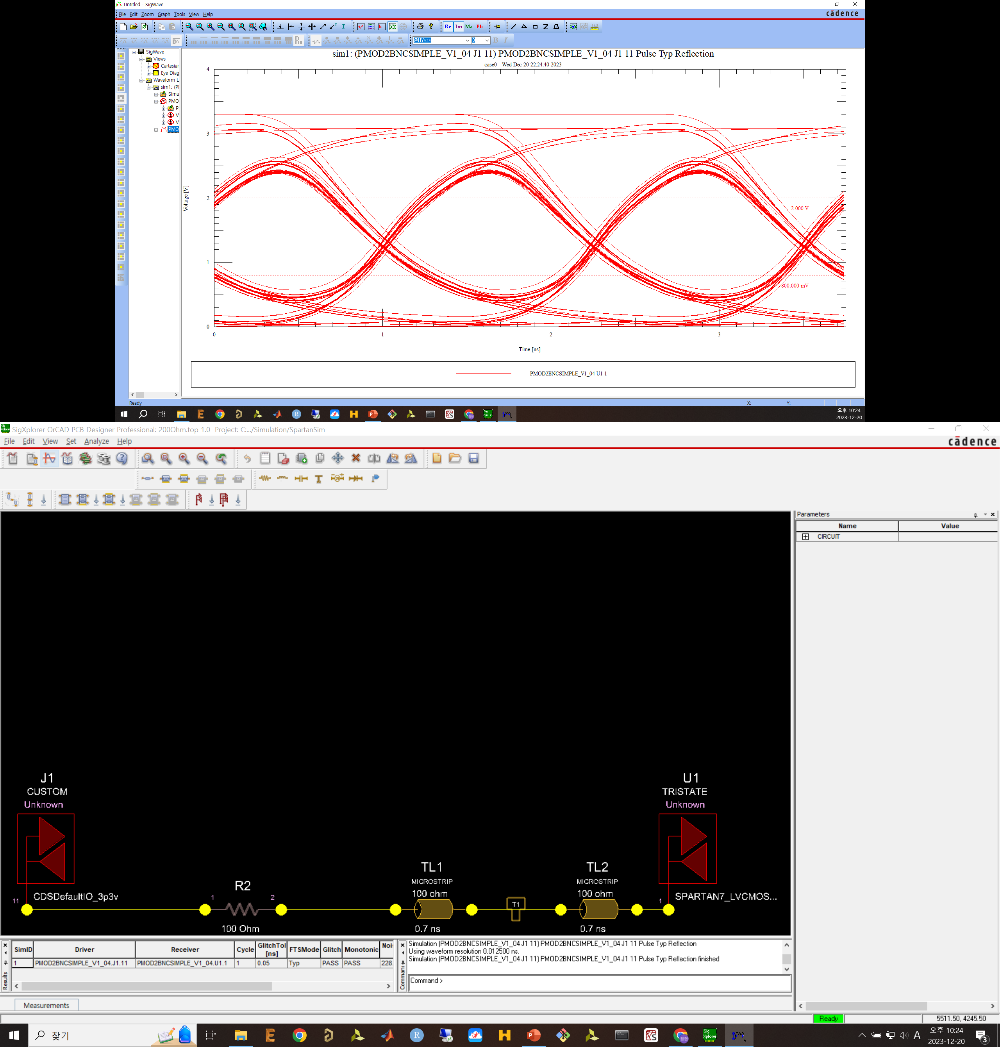
800MHz with matched trace, with 100Ohm series reistor

Slide 26
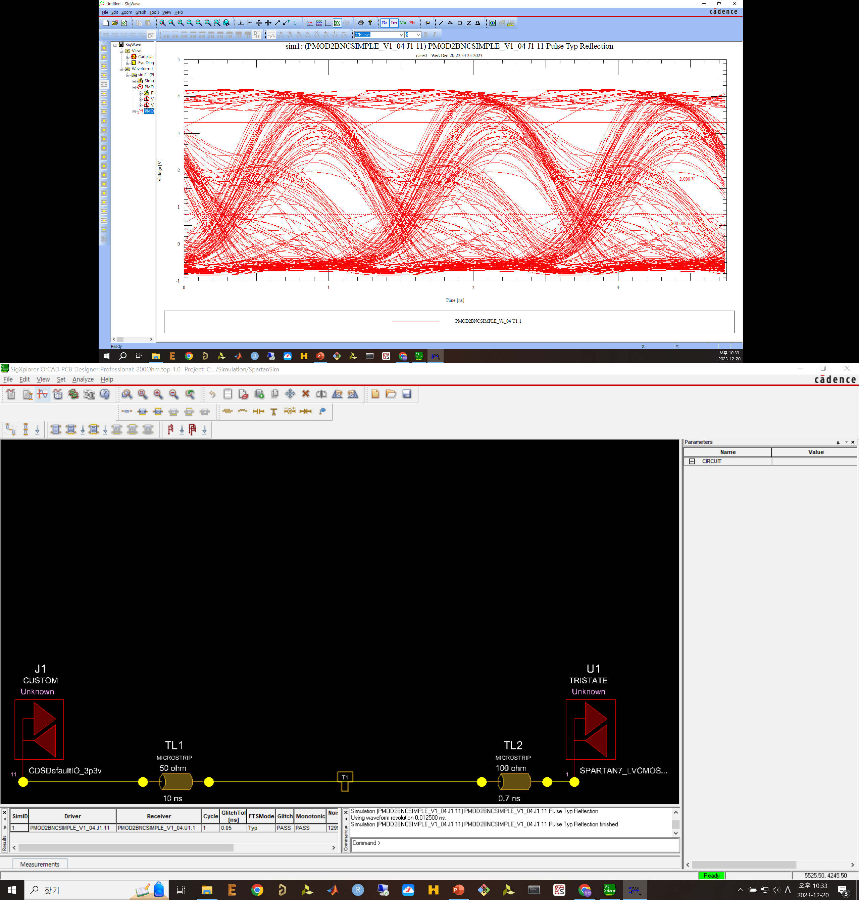
800MHz with nothing

Slide 28


Slide 29
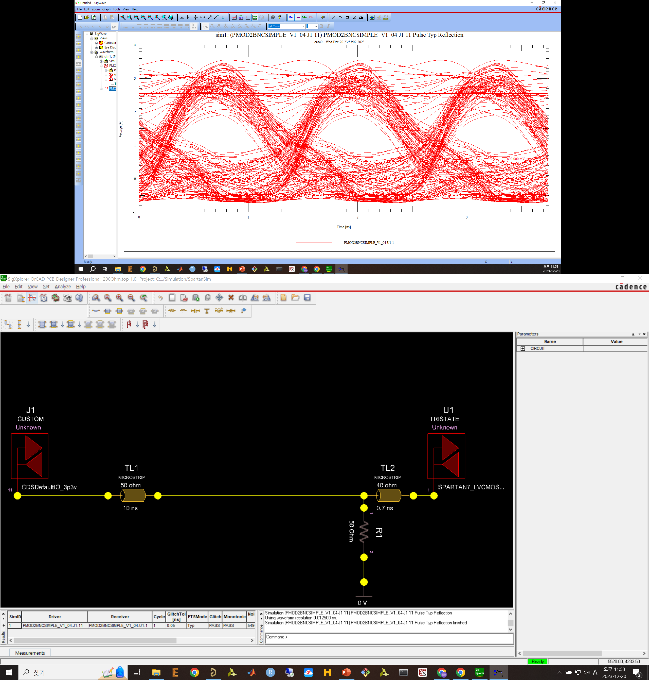

Slide 30
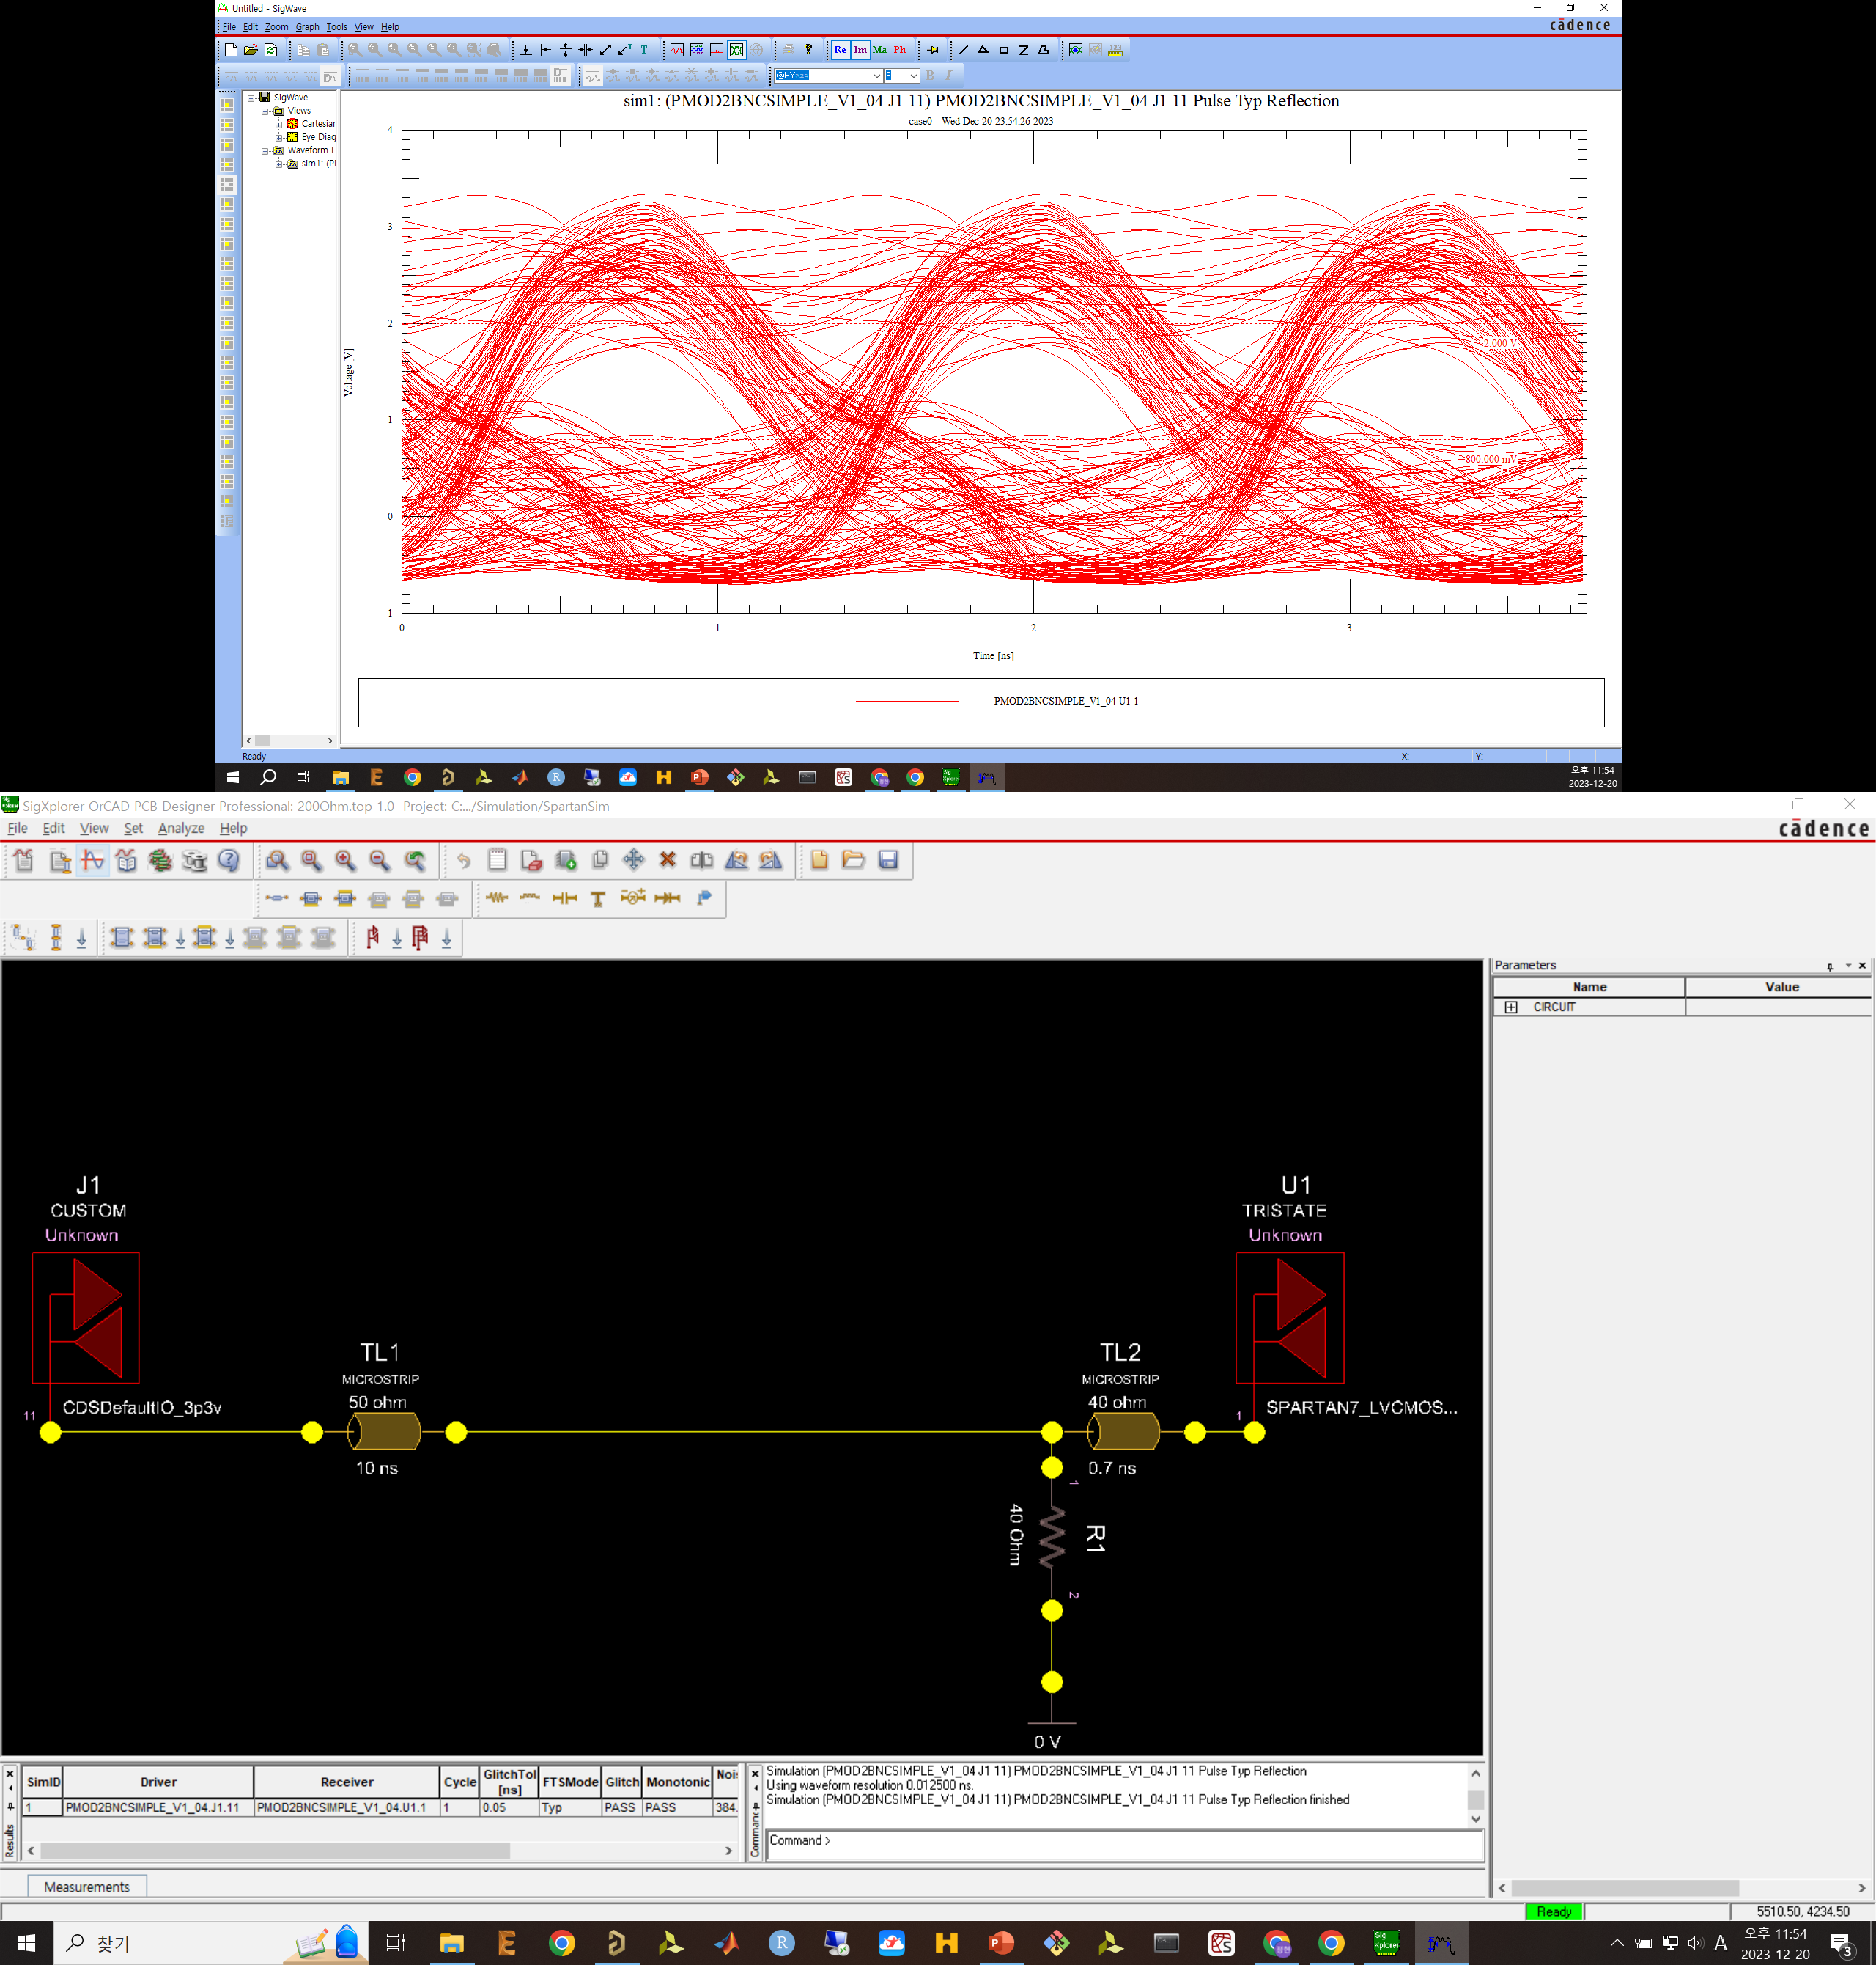

Slide 31
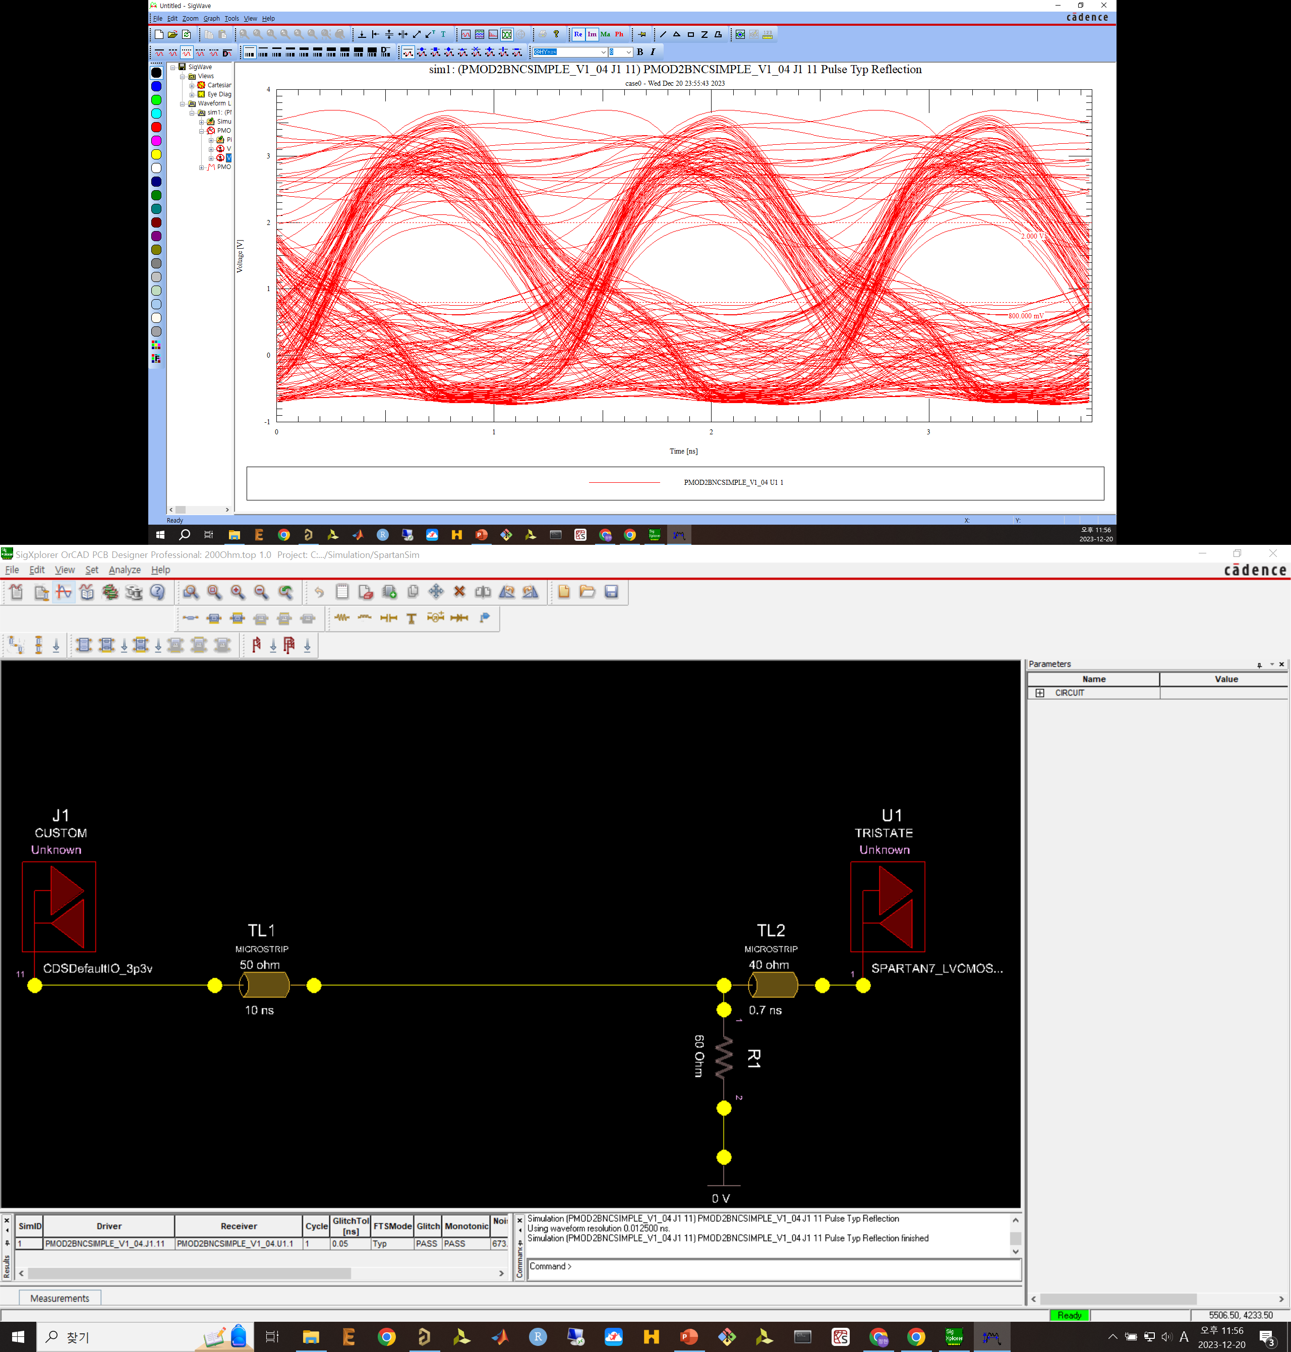

Slide 32
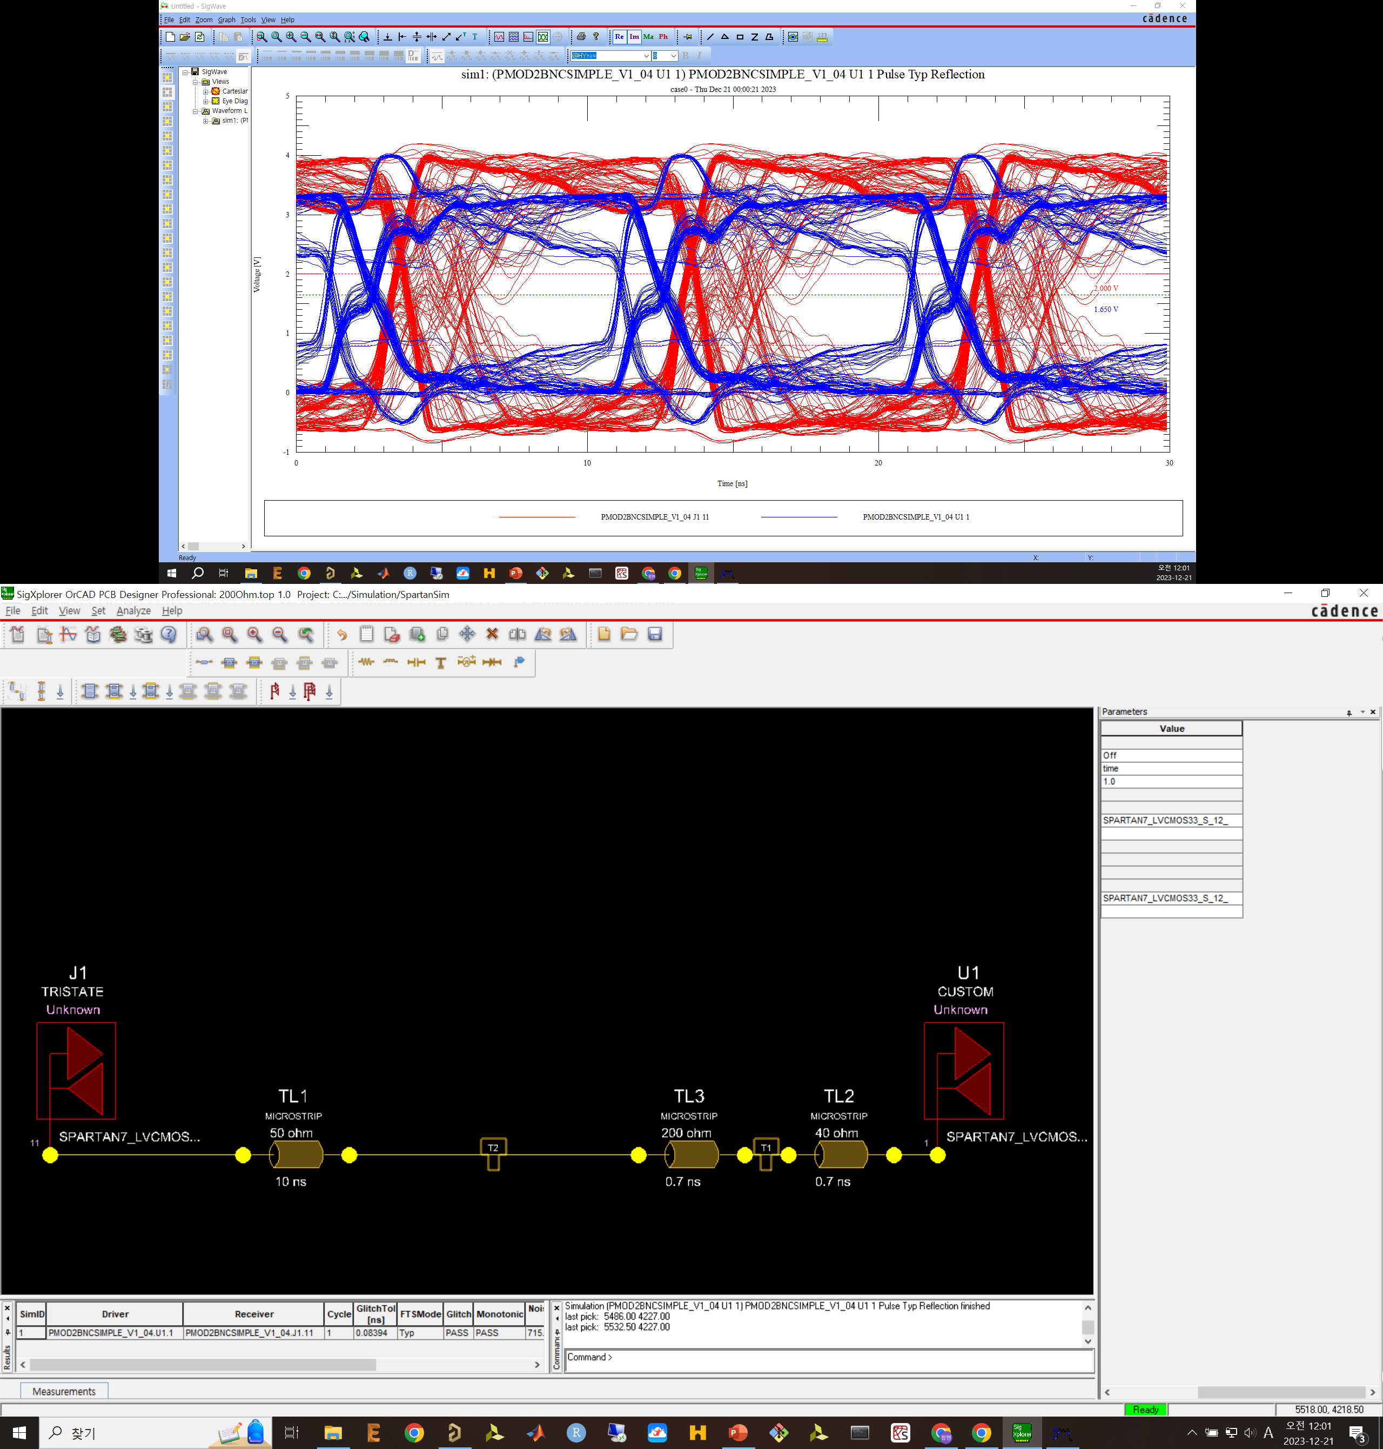

Slide 33
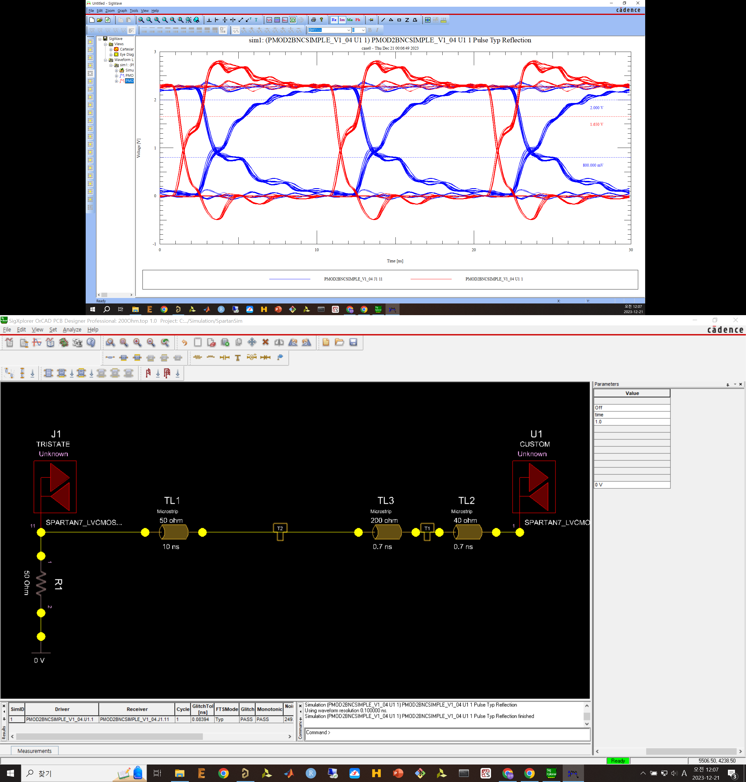

Slide 34
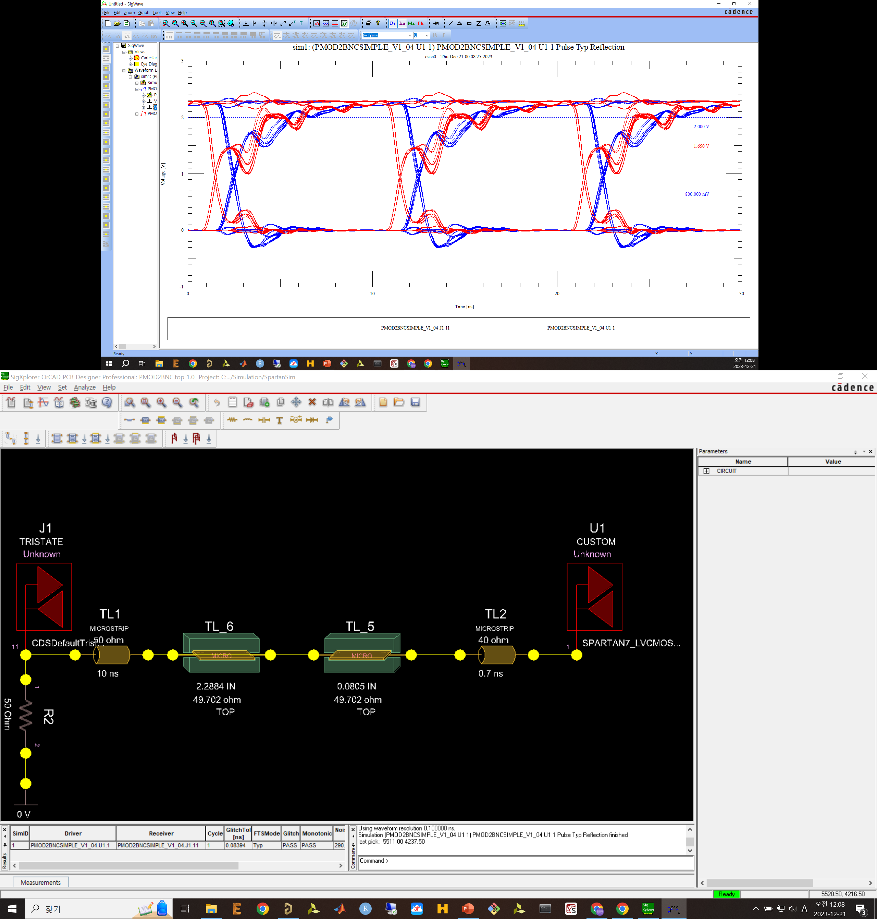

Slide 35
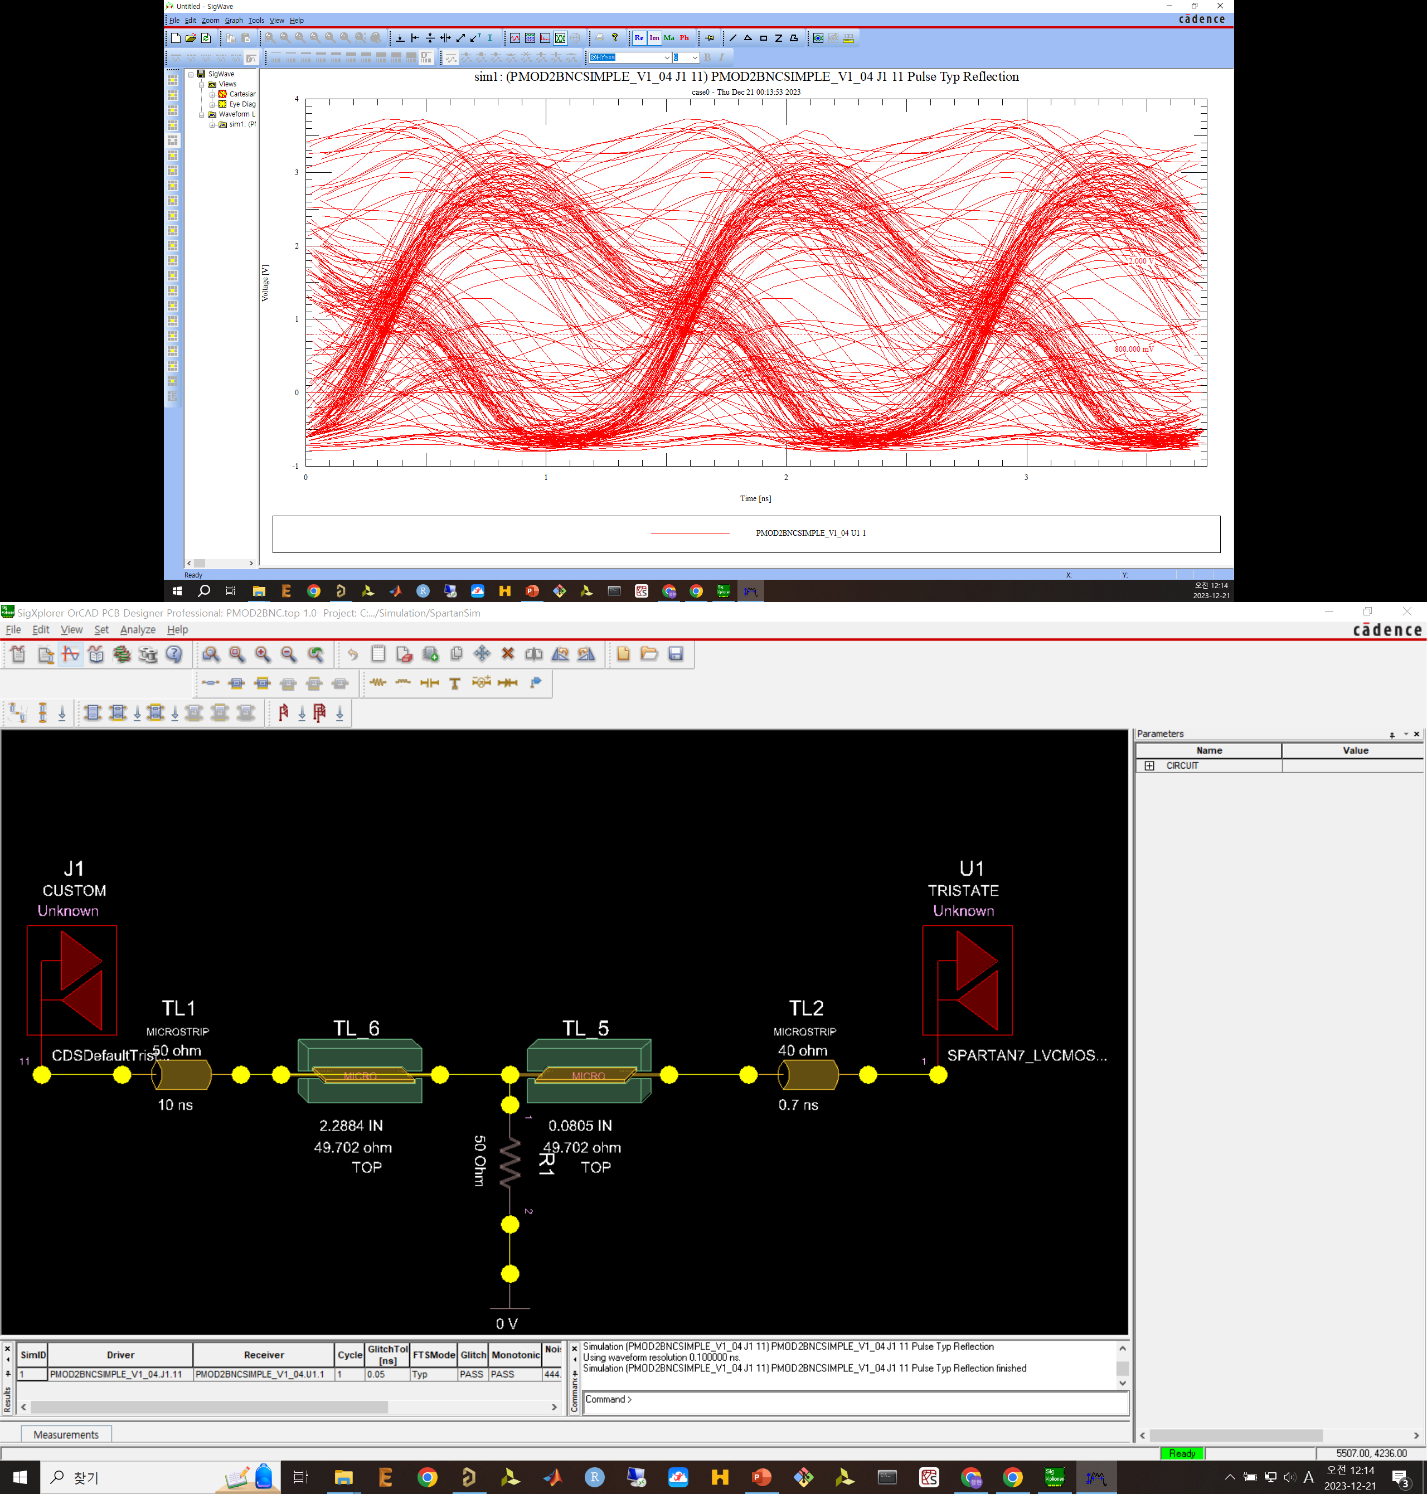

Slide 36
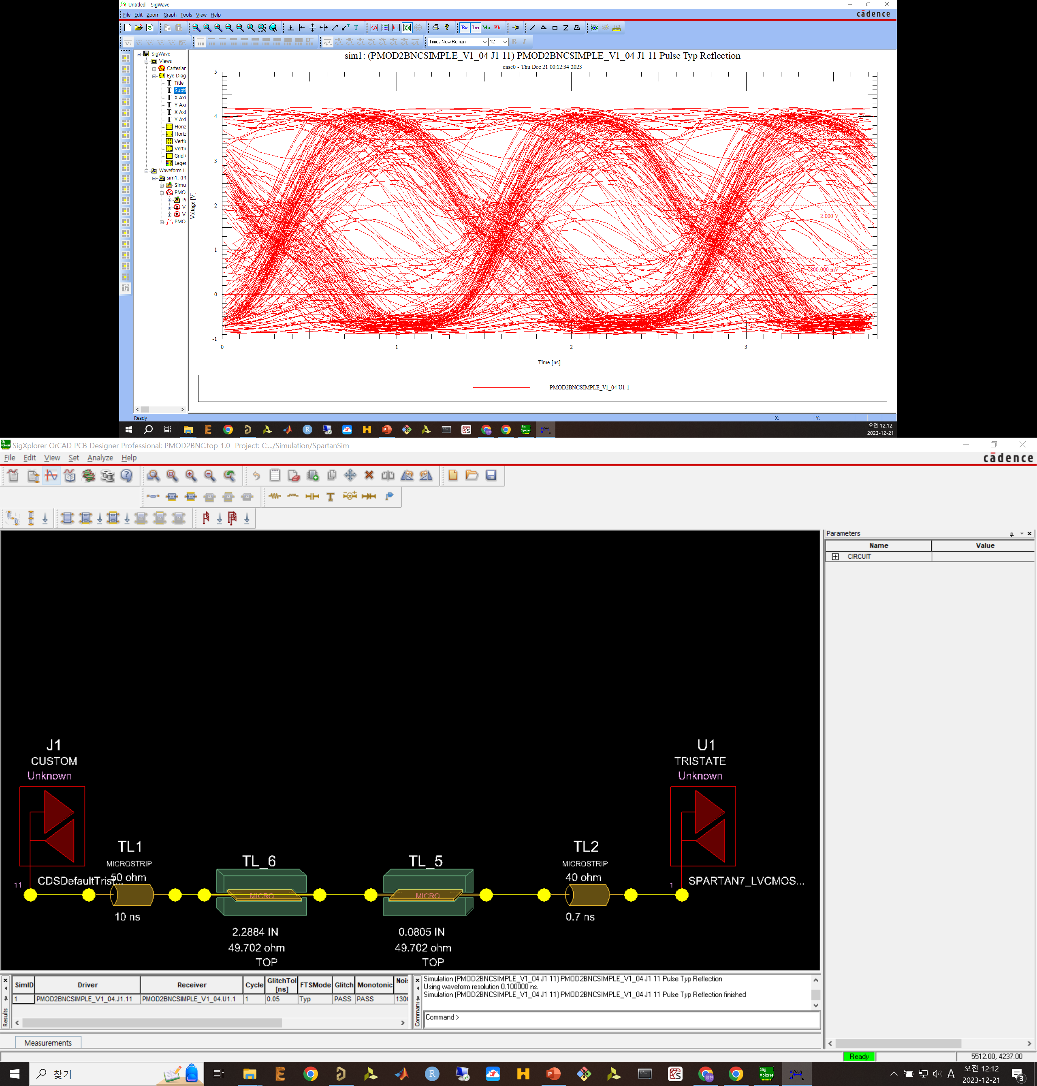

Slide 37
100MHz

Slide 38
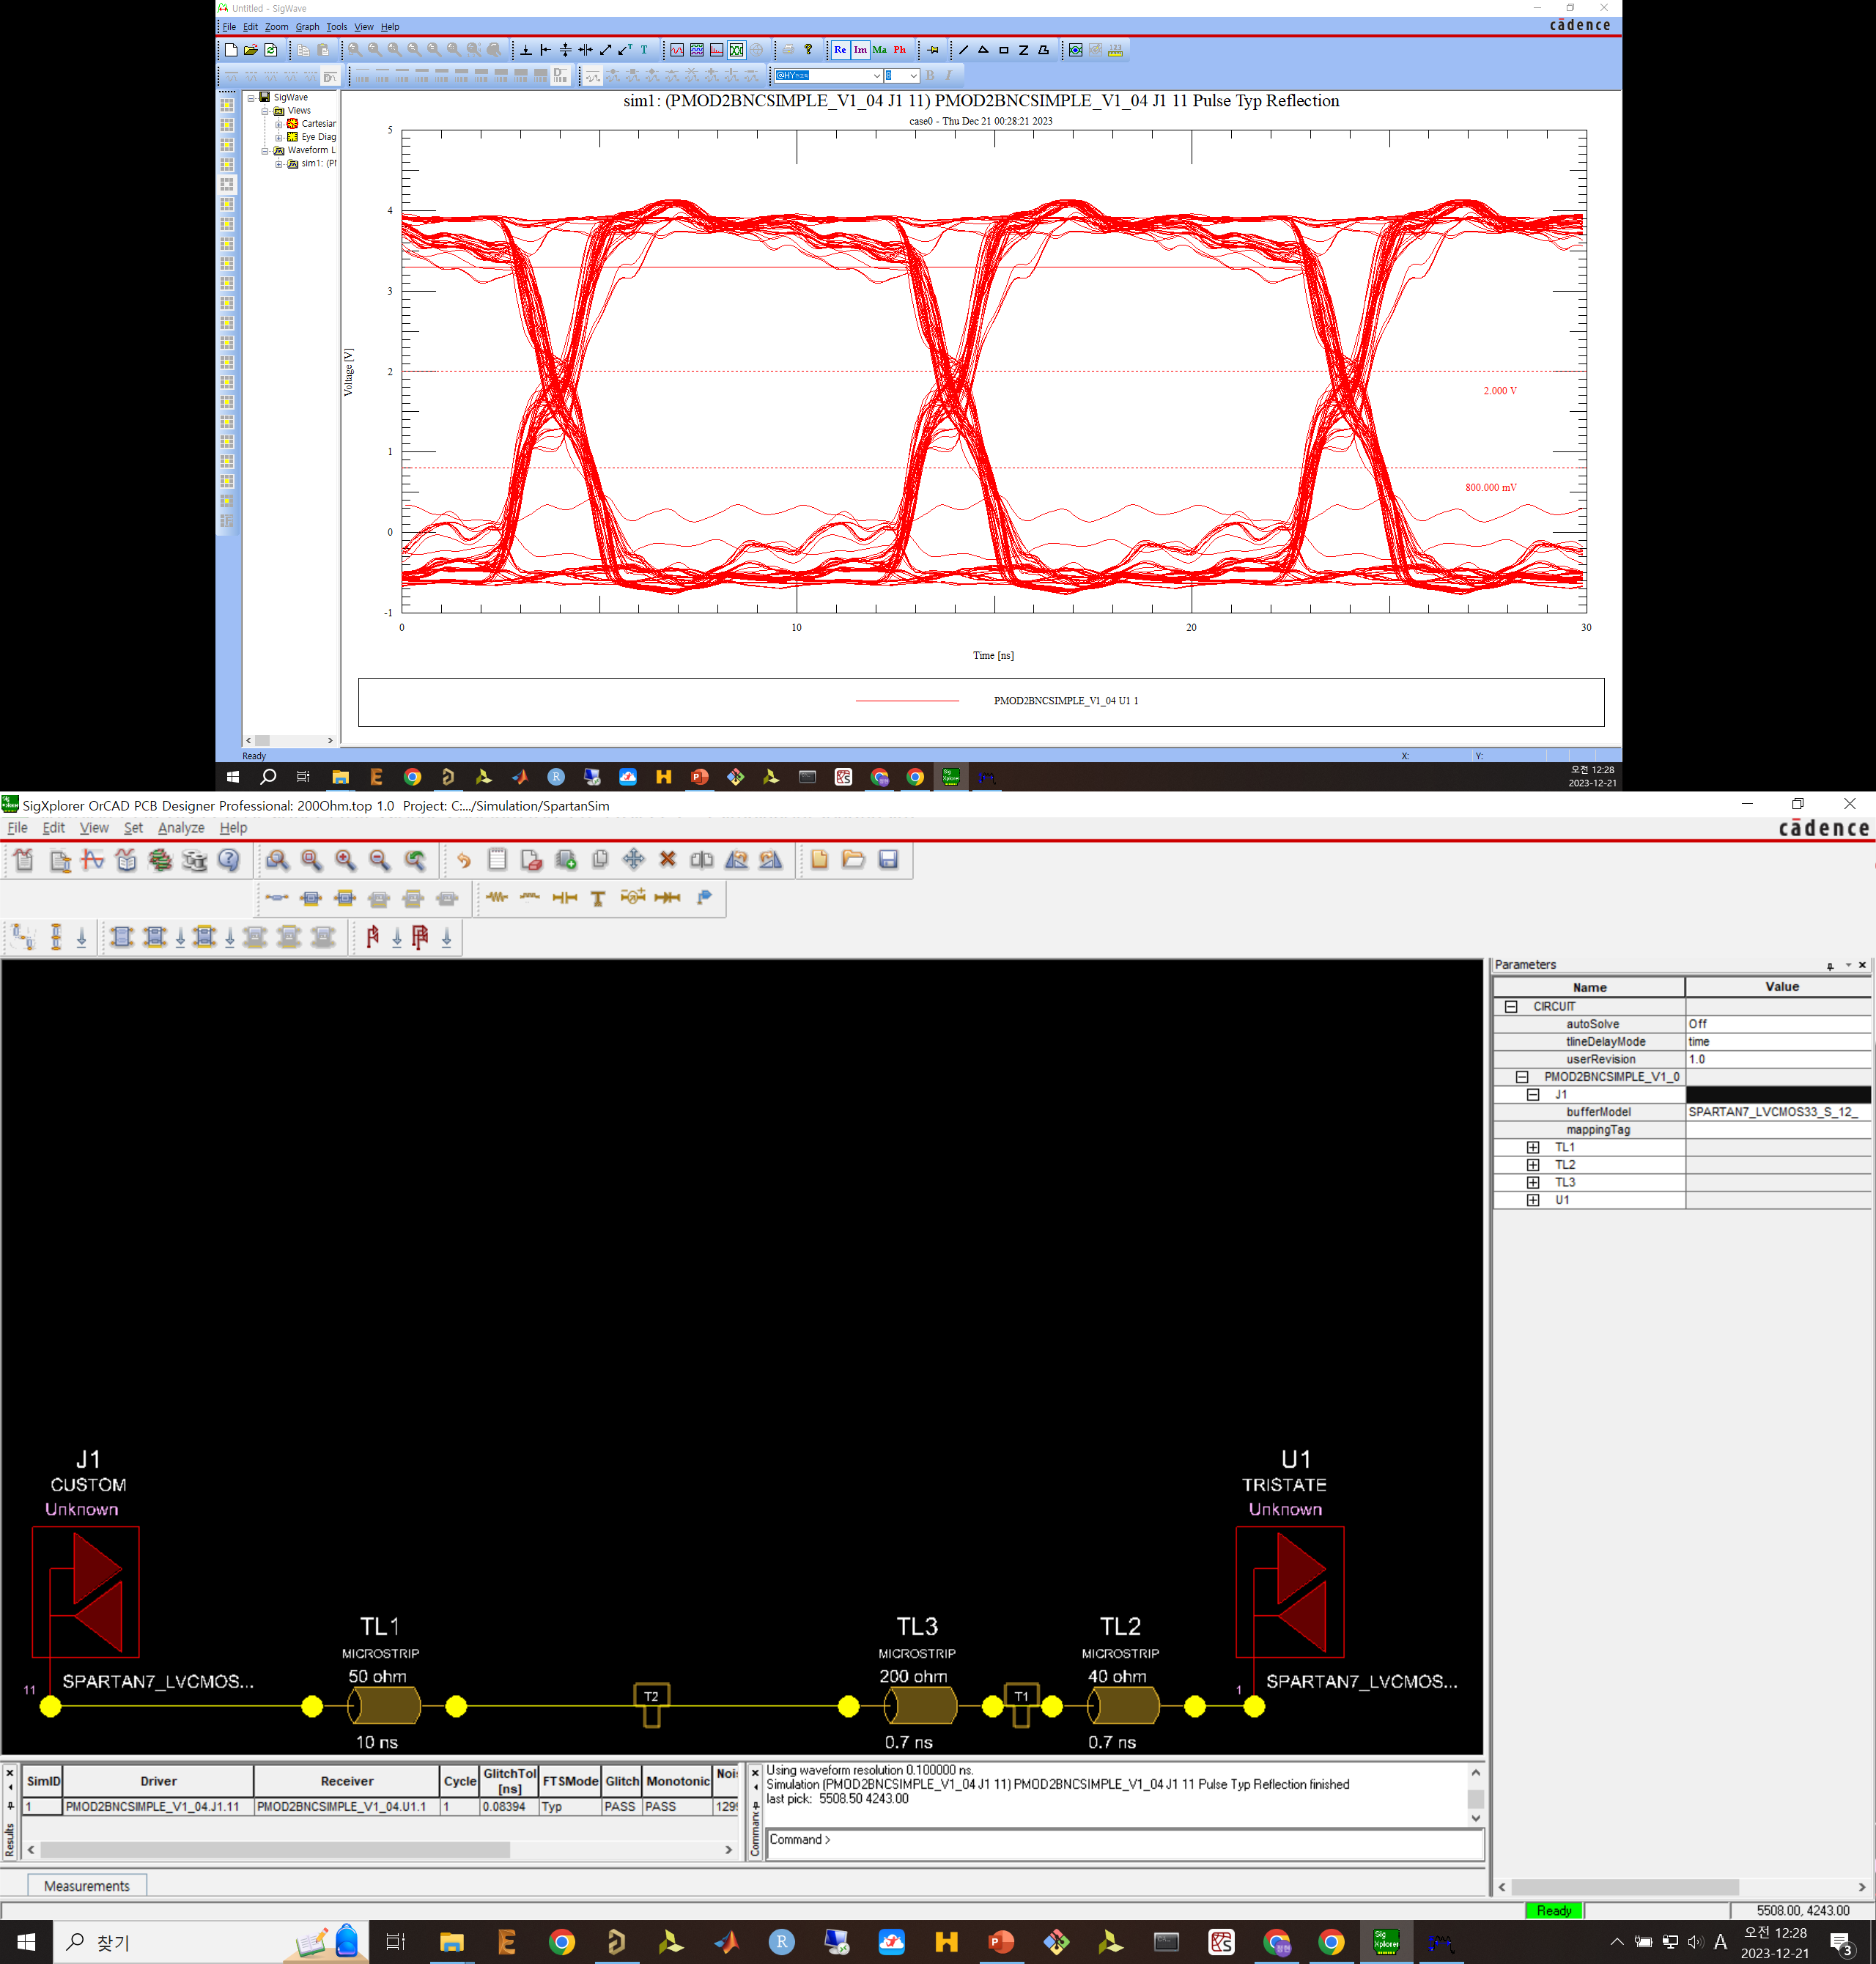

Slide 39
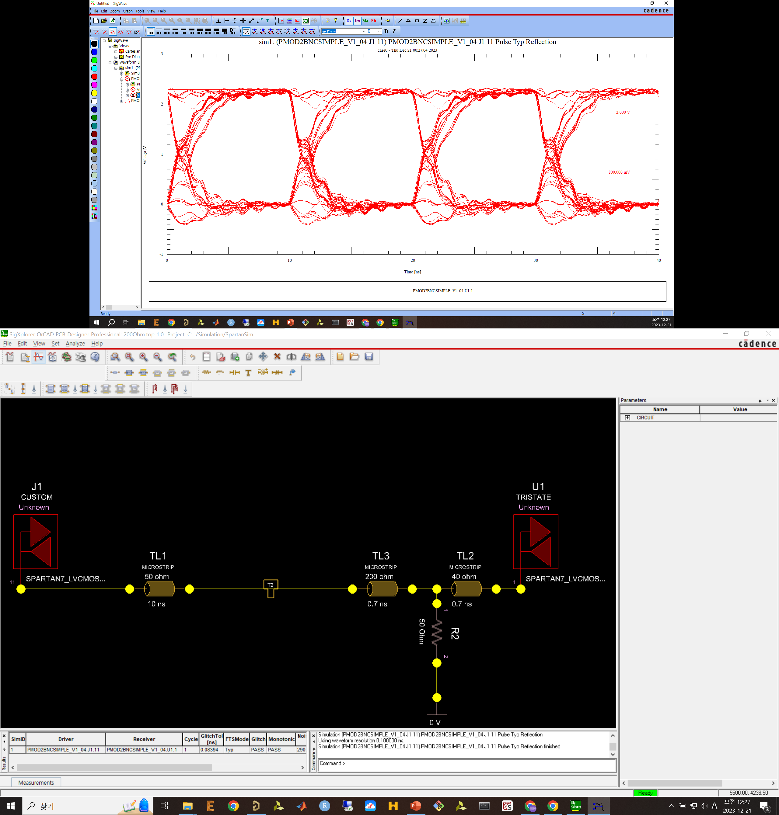

Slide 40
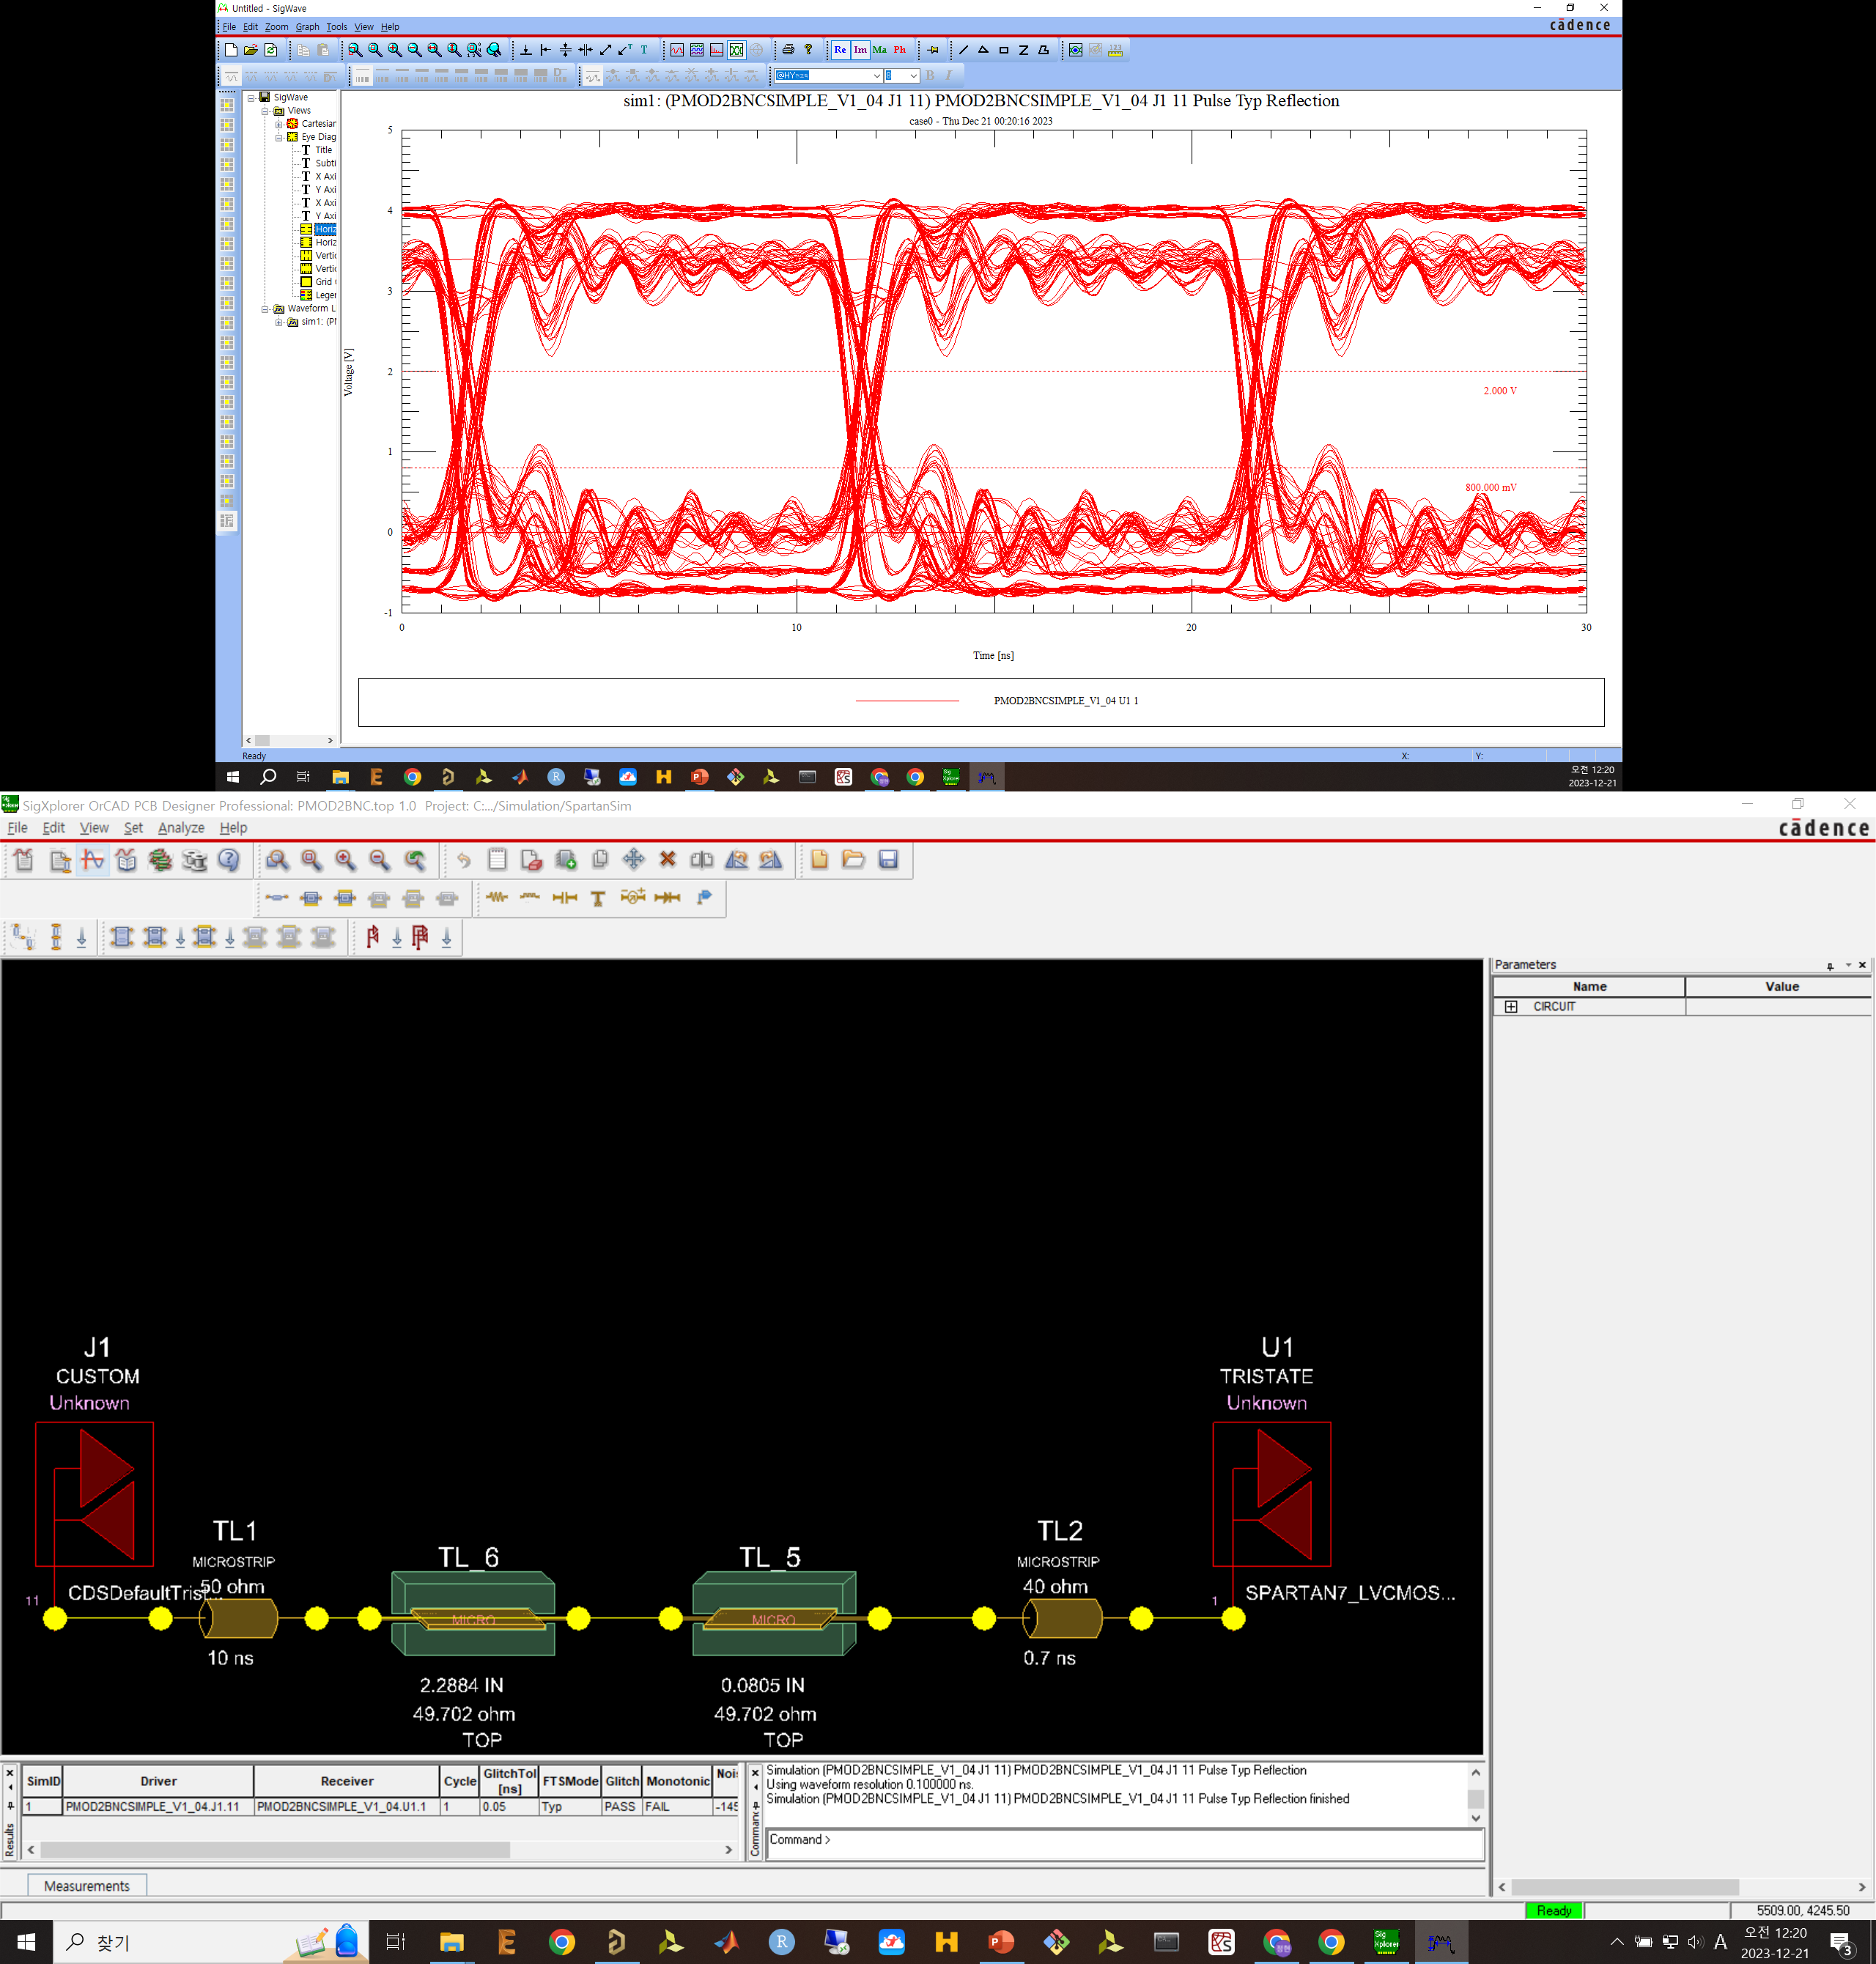

Slide 41
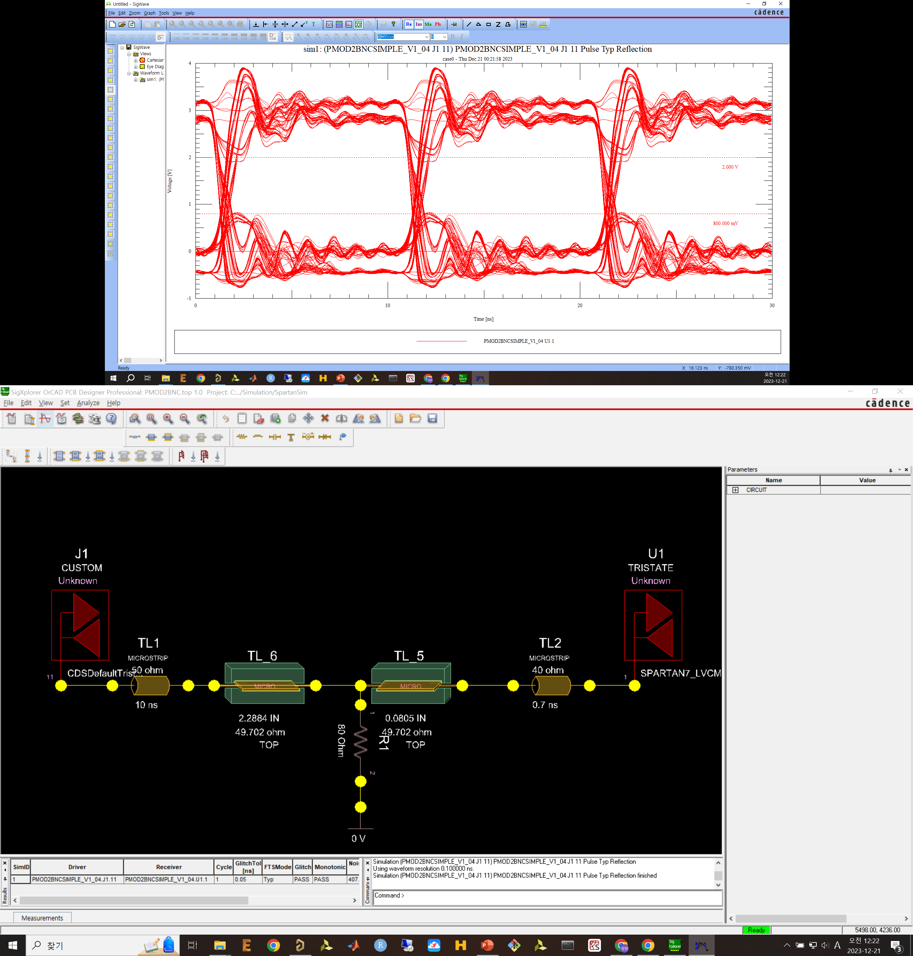

Slide 42


Slide 43


Slide 44
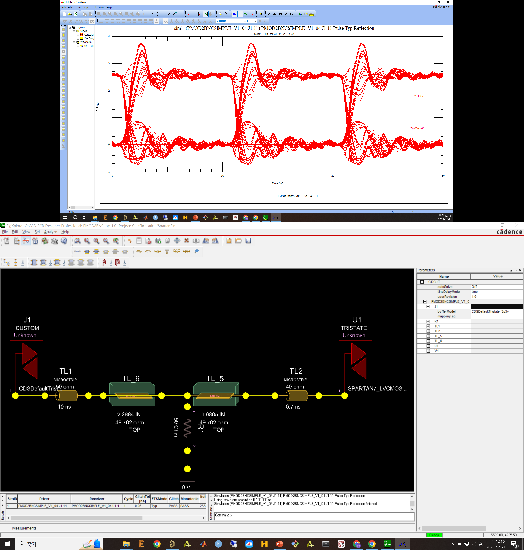

Slide 45


